Slide 1
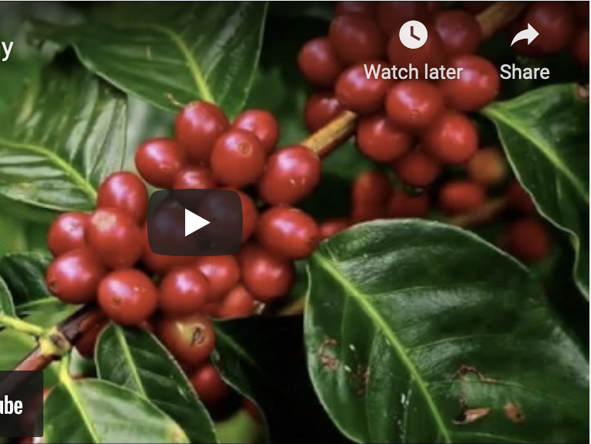
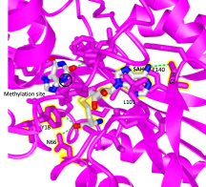
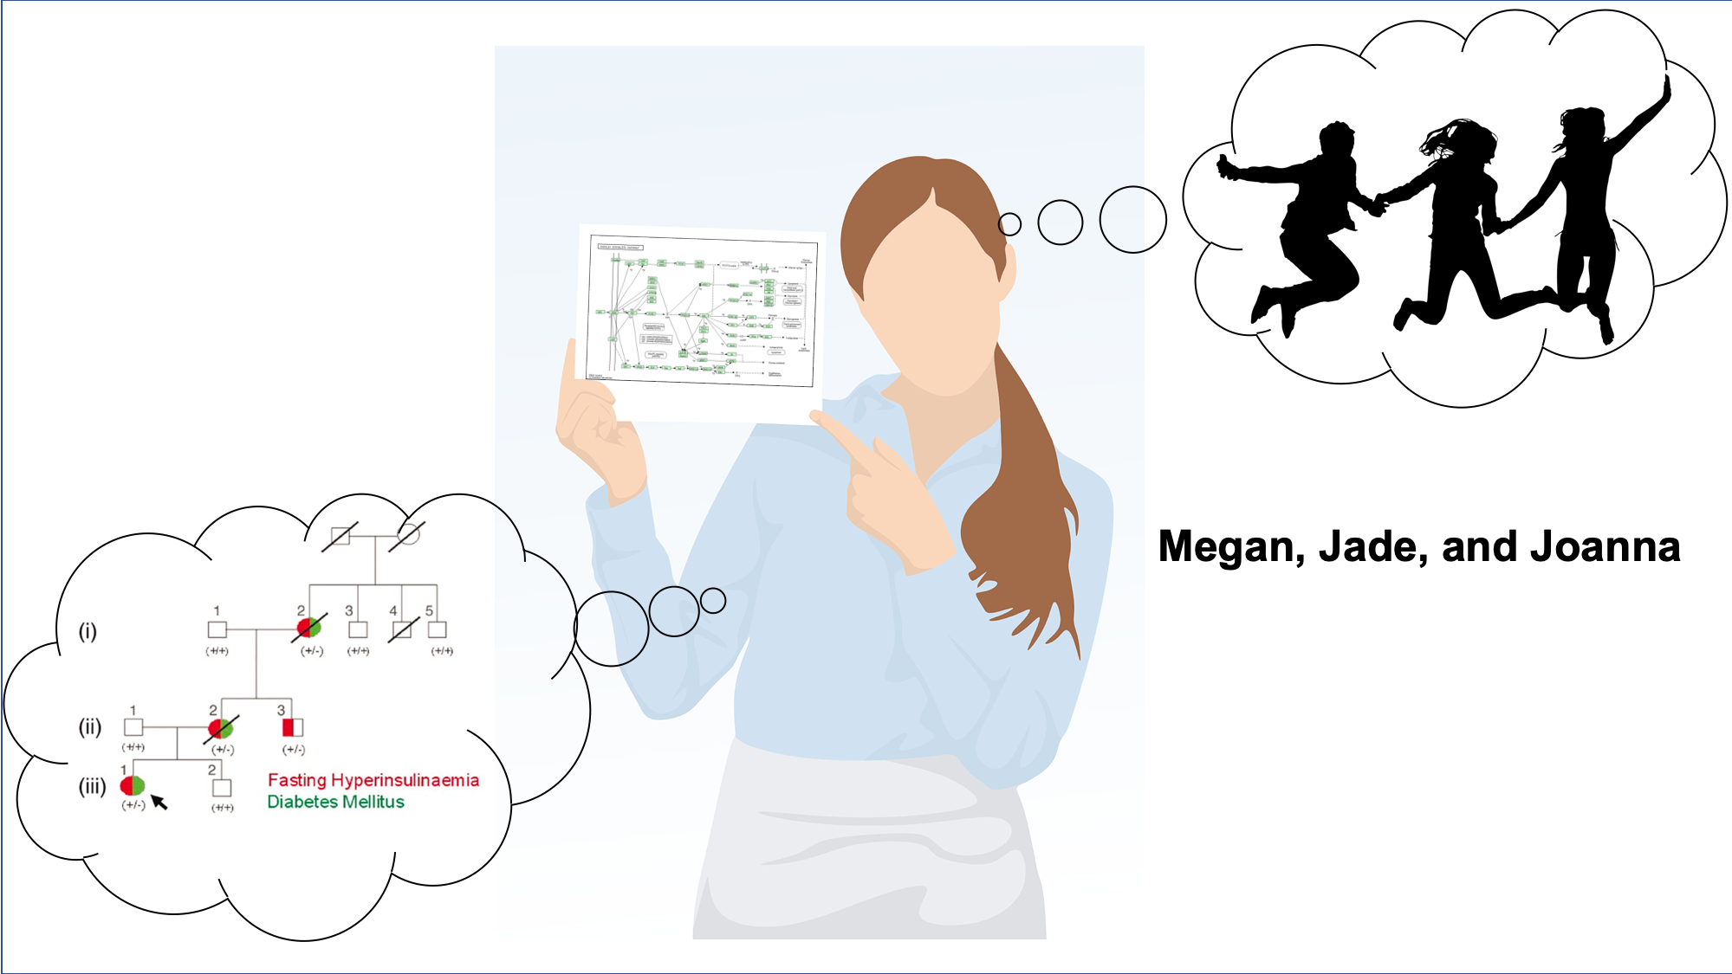
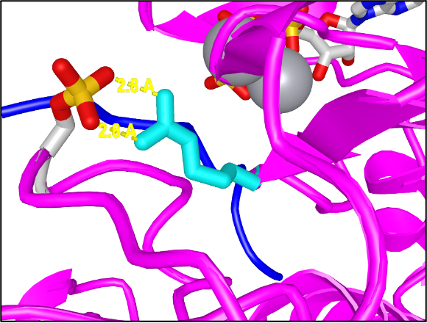
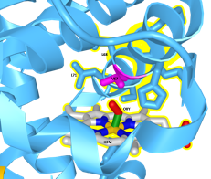
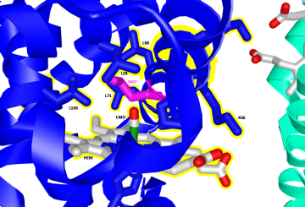
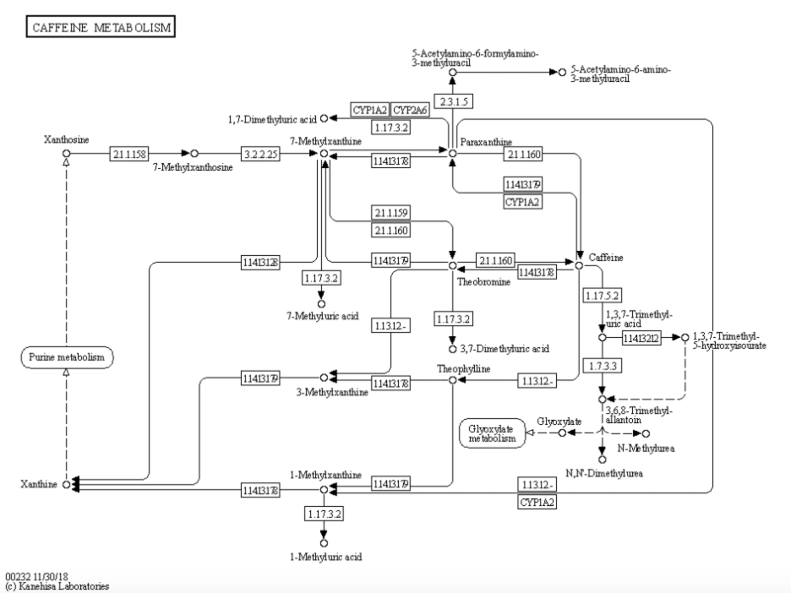
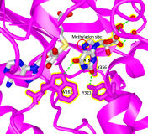
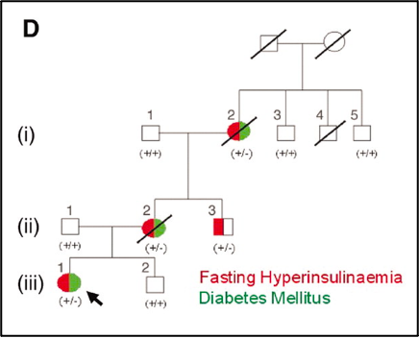
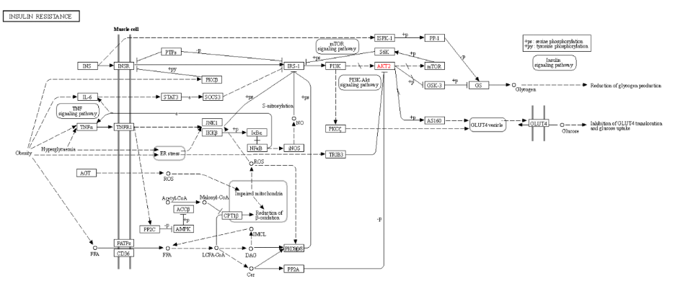
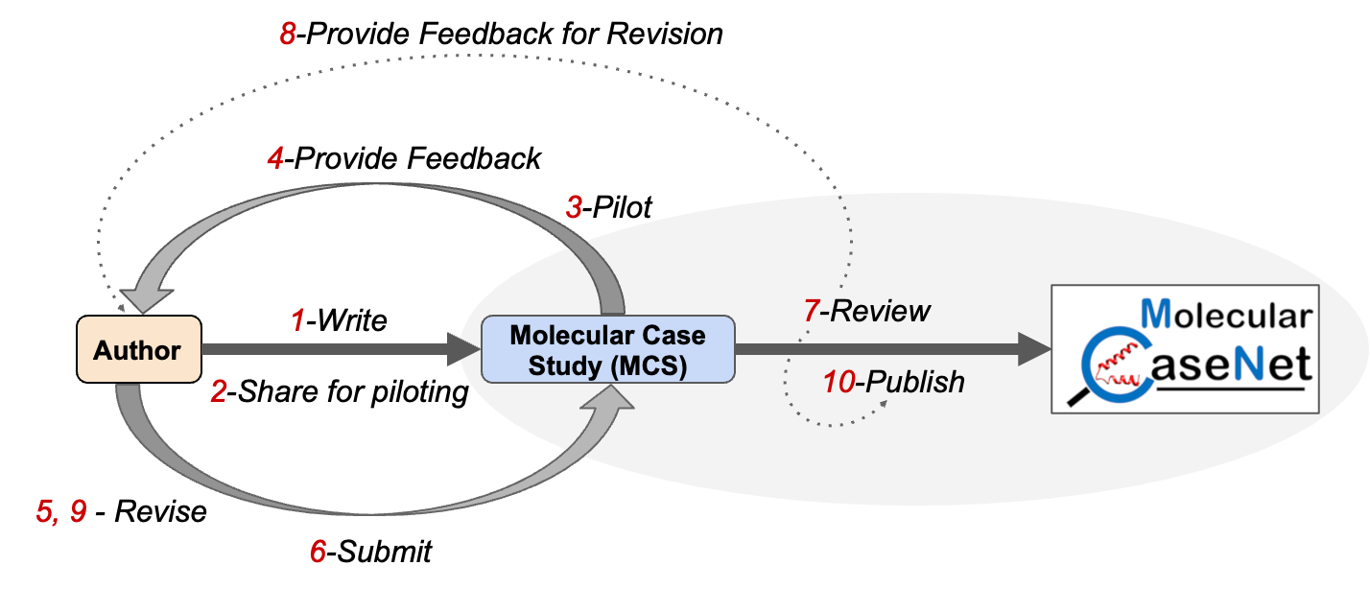
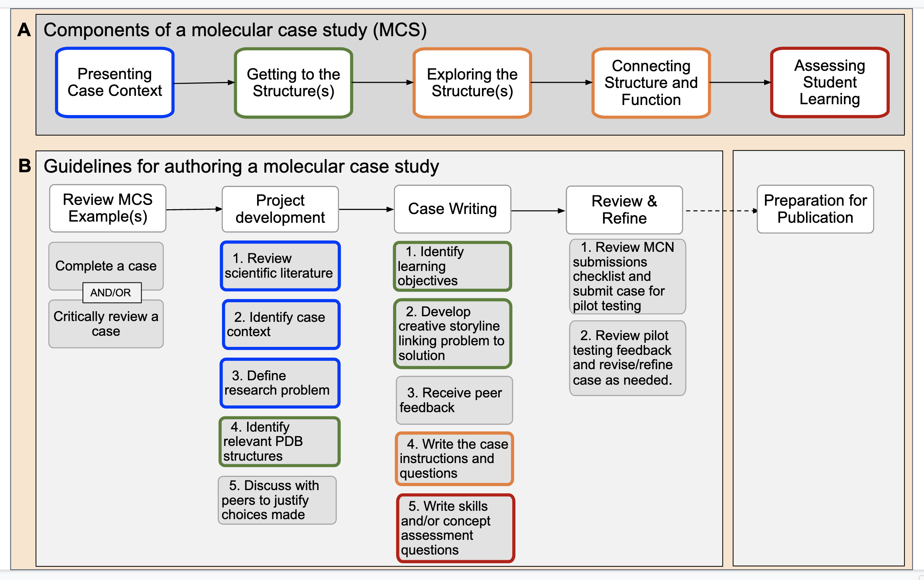
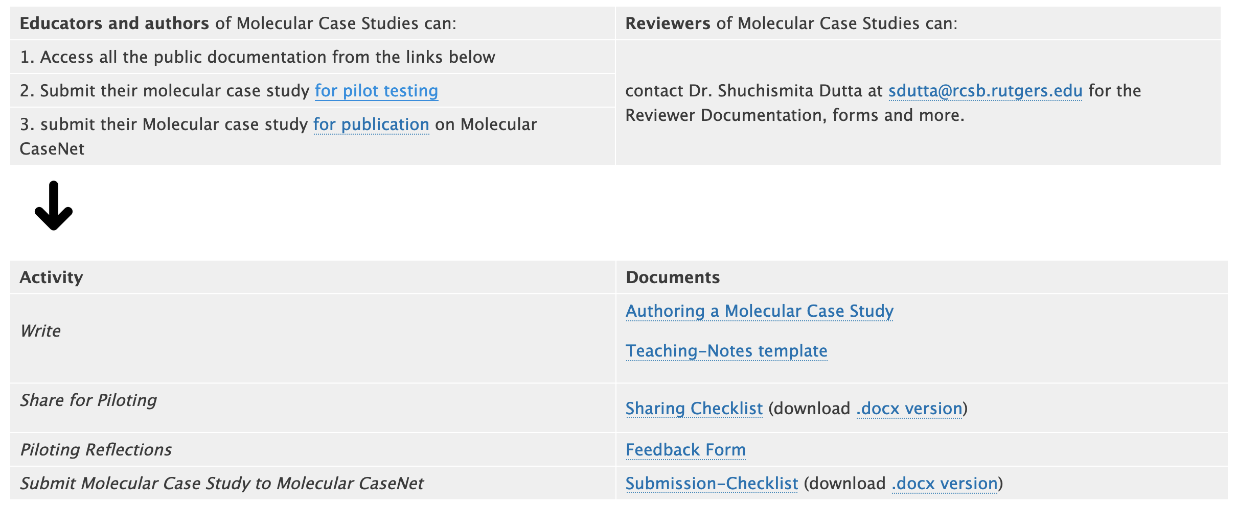
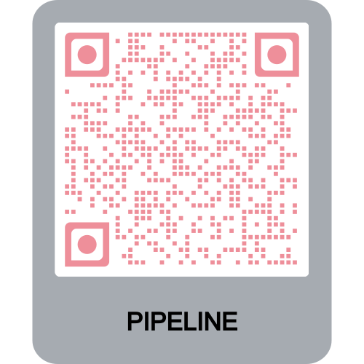
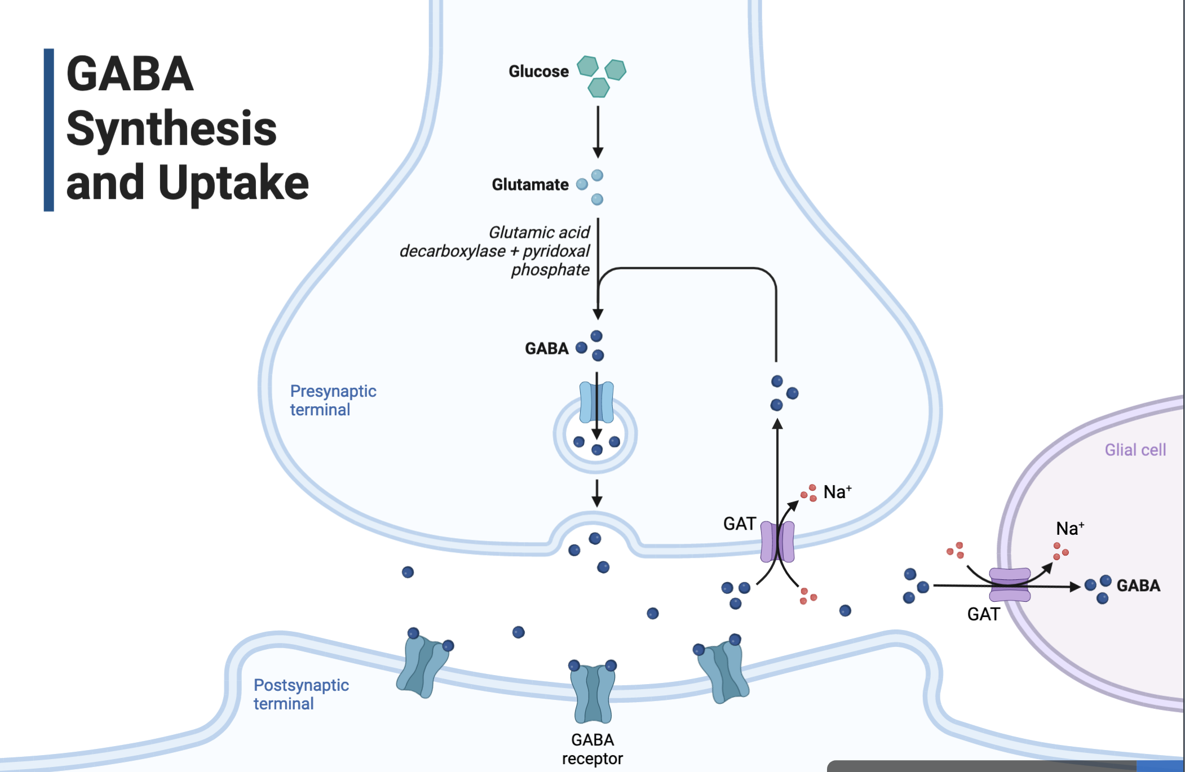
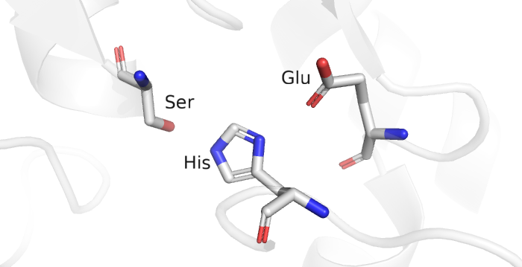
Developing a Pipeline for Authoring, Piloting,
and Evaluating Molecular Case Studies
Kristen Procko Alexandra Pettit Elizabeth Pollock Kasandra J. Riley Didem Vardar-Ulu Shuchismita Dutta
WxThese steps may be repeated (as steps 8, 9) based on feedback from reviewers.
Abstract ID: 1481
Molecular Case Studies at the Interface of Biology and Chemistry
Engaging students in molecular explorations can empower them to make connections between structure and function. Molecular CaseNet (MCN) was created to bring together multidisciplinary educators and scholars to develop and use Molecular Case Studies at the interface of Biology and Chemistry. Each case is designed to provide opportunities to visualize and analyze three-dimensional biomolecular structures relevant to the case theme, then relate the modeled structural features and interactions to functional information derived from bioinformatics resources and the scientific literature. Case studies that are currently published in MCN as Open Education Resources were collaboratively developed by biology, chemistry, and biochemistry educators, in some instances with the involvement of one or more of their students. Topics for these case studies range from various inherited and infectious diseases to evolution of biosynthetic pathways in specific plants. To support the educators and scholars in the growing MCN community, we have developed documentation and checklists that guide authors through the preparation of their case studies, with references to various professional society learning objectives related to structure and function (e.g., from ASBMB, BioCore, NIBLSE, BioMolViz). Discussions between experienced MCN members have helped establish a pipeline for piloting molecular case studies, preparing them for submission, and evaluating them to provide feedback from biomolecular visualization experts and case theme-related disciplinary experts. We present the preliminary work toward developing this pipeline, including a map of our review process, the key elements required for a molecular case study, and strategies to adapt cases for different learning environments. We invite instructors of all levels of biology and chemistry to explore our repository of molecular case studies, utilize them to teach structure-function relationships, and contribute to the pipeline by providing feedback about the use of these case studies in diverse classrooms.
What are they?
These case studies are opportunities for telling molecular stories to engage students in exploring biomolecular structure-function relationships.
Components of each case study include
a hook (such as a video, narrative, image, or report), to engage and present the case context
guidance to identify key molecular players in the story and find their relevant 3D structures to study
guidance for molecular visualization and analysis of 3D structures related to the case theme
opportunities to integrate information from the literature, bioinformatics resources, and connect with biomolecular structure and function.
Examples
Why should you consider using them?
Where can you find them?
Browse case studies at Molecular CaseNet (molecular-casenet.rcsb.org)
Educators can request for access to answer keys and teaching notes.
Adopt and adapt case studies to meet your curricular needs.
Query, navigation, and integration of information from various public bioinformatics resources
Practice biomolecular structure visualization and analysis
In-depth understanding of intra- and inter-molecular forces in proteins, nucleic acids and their complexes
Active learning opportunities
Modular, flexible, adaptable
Answer keys and teaching notes included
Opportunity to apply multidisciplinary concepts learned in class to authentic societal issues
Happy Blue Baby
(doi:10.25334/2R67-W933)
Evolution of Caffeine Biosynthesis Enzymes
(doi:10.25334/225Z-KR22)
A Case of Severe Insulin Resistance
(doi:10.25334/DTTA-WW18)
AKT2:
Functional role of R274
Funding:
This work is supported by the National Science Foundation awards NSF DBI-1827011 and 2018884.
Molecular Case Studies are published as open education resources using the BioQues/QUBES platform and are available at https://qubeshub.org/community/groups/molcasenet
DXMT
Caffeine Synthesis
XMT
Native Hb
Mutant Hb
Insulin Resistance
at AKT2
A Pipeline for Authoring, Piloting, Reviewing and Publishing Molecular Case Studies
1. Author Molecular Case Study
Detailed Documentation Available for …
2. Share Case Study for Field Testing
3. & 4. Pilot and
Provide Feedback
Self-checklist review to ensure all required components of the molecular case study are included.
Author provided teaching notes to guide classroom implementation
Educators pilot and provide feedback to authors
7. Review of submitted Molecular Case Studies
5. & 6. Revise and Submit Molecular Case Study
10. Publish
the Molecular Case Study
These steps may be repeated (as steps 8, 9) based on feedback from reviewers.
Molecular CaseNet invites you to
Explore the published Molecular Case Studies and use ones that meets your course objectives and curricular goals
Author a Molecular Case Study independently or collaboratively about a topic of your choice
Engage your students in authoring molecular case studies as a partial Course-based Undergraduate Research Experience (CURE)
Pilot ‘Molecular Case Studies for Field Testing’ and provide feedback to the authors
Join the Molecular CaseNet Review Committee to help review Molecular Case Studies
Subject matter experts review discipline-specific aspects of the case study
Senior MCN members review biomolecular modeling aspects of the molecular case study
References
Goodsell D.S., Dutta S., Voigt M., Zardecki C. (2021) Molecular storytelling for online structural biology outreach and education. Struct Dyn. 8(2):020401. doi: 10.1063/4.0000077.
Riley, K.J., Vardar-Ulu, D., Pollock, E., Dutta, S. (2021) Students authoring molecular case studies as a partial course‐based undergraduate research experience (CURE) for lab instruction, BAMBEd 49: 853-855, doi: 10.1002/bmb.21578
Dutta S. (2020) The Molecular Case Study Cycle. CCCE: Committee on Computers in Chemical Education Newsletter
Dutta S., Dries D.R. (2019) Virtual Exploration of Biomolecular Structure and Function. Biochemistry Education: From Theory to Practice, Chapter 2pp 21-41, ACS Symposium Series Vol. 1337, doi: 10.1021/bk-2019-1337.ch002

