Slide 1
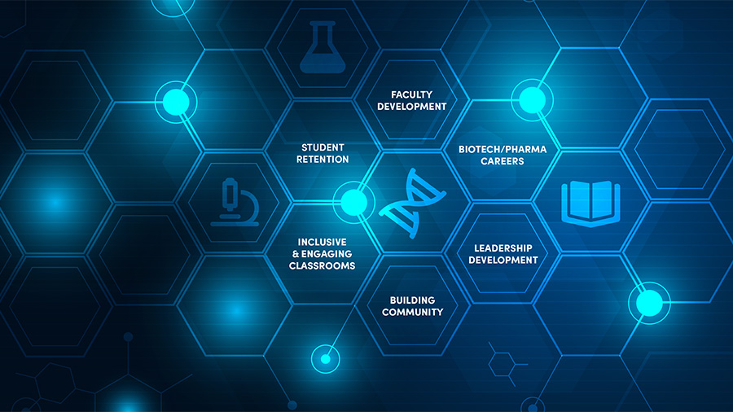
Molecular CaseNet:
An invitation to join this community
to Use and Develop Molecular Case Studies
at the Interface of Biology and Chemistry
Shuchismita Dutta, Ph.D.
Scientific Training, Education, and Documentation Lead, RCSB Protein Data Bank
Associate Research Professor, Institute for Quantitative Biomedicine
Member, Cancer Pharmacology, Cancer Institute of New Jersey
Rutgers, The State University of New Jersey

Slide 2
Outline
The Molecular Case Study cycle
Try a Molecular Case Study
Develop your Molecular Case Study
Invitation to join us

Slide 3
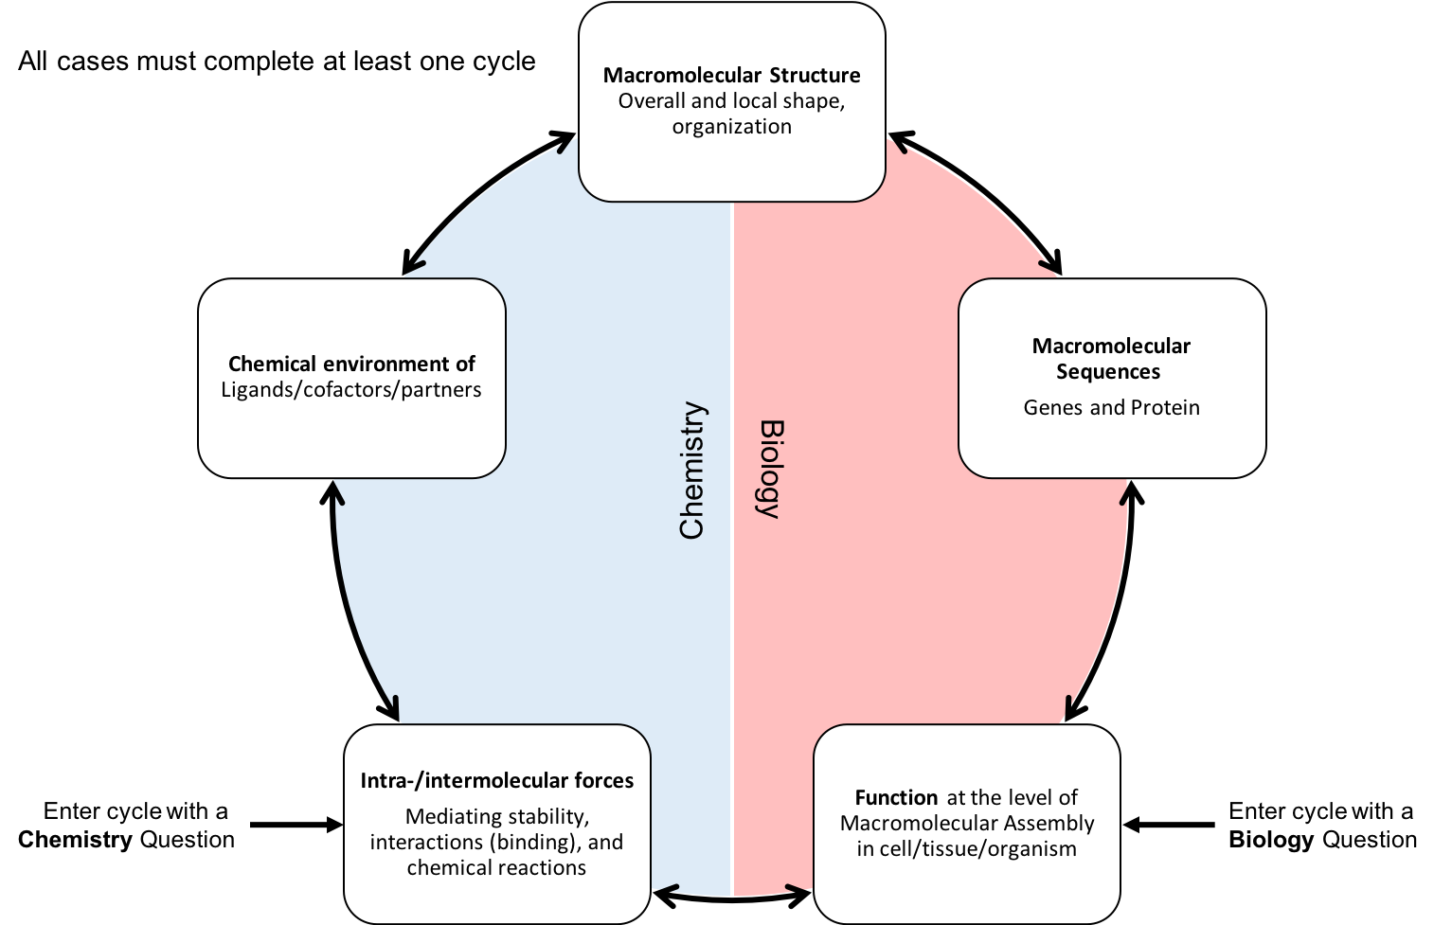
Outline
The Molecular Case Study cycle
Try a Molecular Case Study
Develop your Molecular Case Study
Invitation to join us

Slide 4
Outline
The Molecular Case Study cycle
Try a Molecular Case Study
Develop your Molecular Case Study
Invitation to join us
Happy Blue Baby

Slide 5
Happy Blue Baby
In 2008, Weiss (Dr. Mitchell Weiss) was rounding the wards at CHOP (Children's Hospital of Philadelphia) when he came across an unusual case. An infant from the Jersey Shore had just arrived at the hospital with an unexplained problem. Her skin had a purple-blue tinge, a condition called cyanosis, which indicates not enough oxygen-rich blood is reaching cells in the body.
"The list of things that can cause cyanosis is long," Weiss said. The neonatal intensive care unit at the hospital where the baby girl was born had done workups for the most common culprits, which included some frightening possibilities: congenital heart diseases, lung disorders.
Everything was negative. Not only that, she was happy and alert, though slightly anemic.
"So then they called us," Weiss said.
The most important clue came soon after.
"We're looking at this baby, and the grandmother comes up and says, 'My son had the same thing,'" said Weiss. The little girl's father was also born blue, said the grandmother. Doctors made a fuss and did a major evaluation. Nothing. Six months later, he was healthy
That was a eureka moment, Weiss said, because "when you hear that, you think of a fetal hemoglobin problem."
Q1. What symptoms did the newborn baby girl have when she was brought to the Children's Hospital of Philadelphia?
Q3. Based on the article what molecule(s) is/are affected? What was the diagnosis?
Genetic Mutation, Named for Toms River, May Shed Light on Blood Disorders, Graelyn Brashear (2011), The Patch, Community Corner

Slide 6
Let’s Explore …
Go to www.rcsb.org
Search for Toms River (top search box)
In PDB entry identified - locate V67M
Find a structure without the mutation
Locate V67
Compare structures
Side-by-side
Superposed
Why was the baby blue?

Slide 7
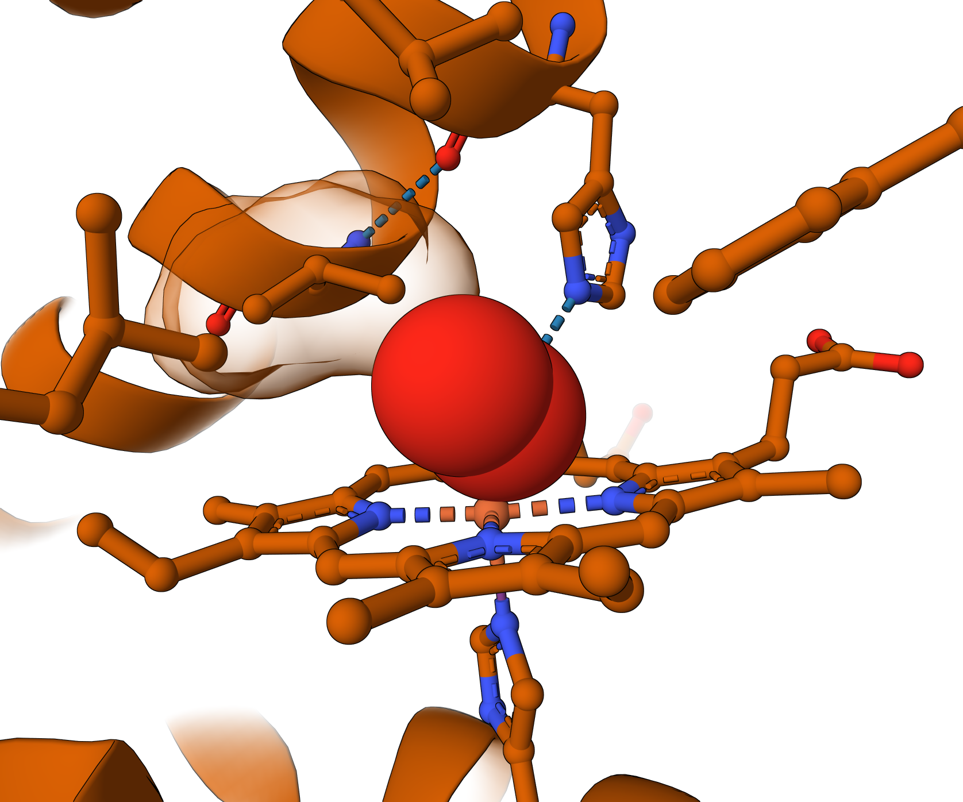
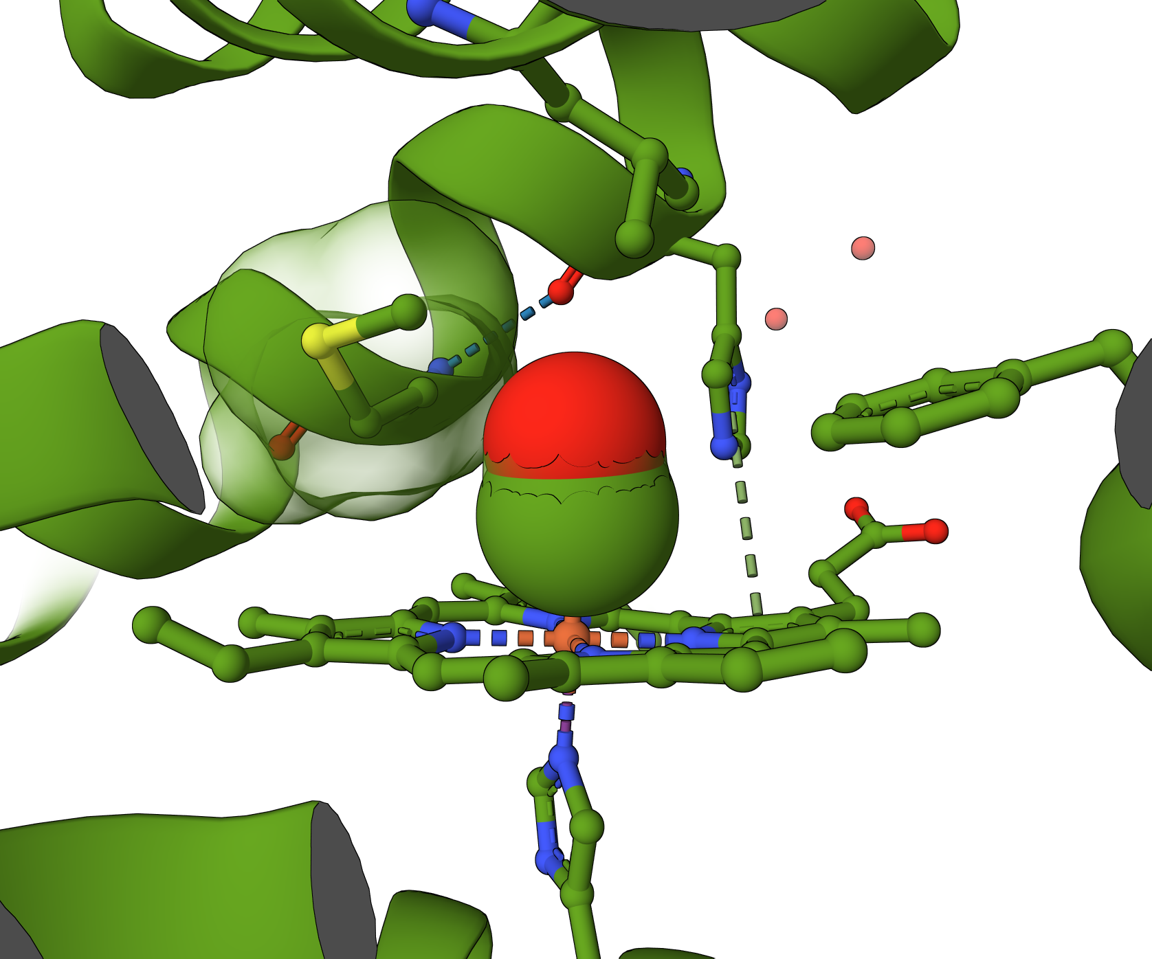
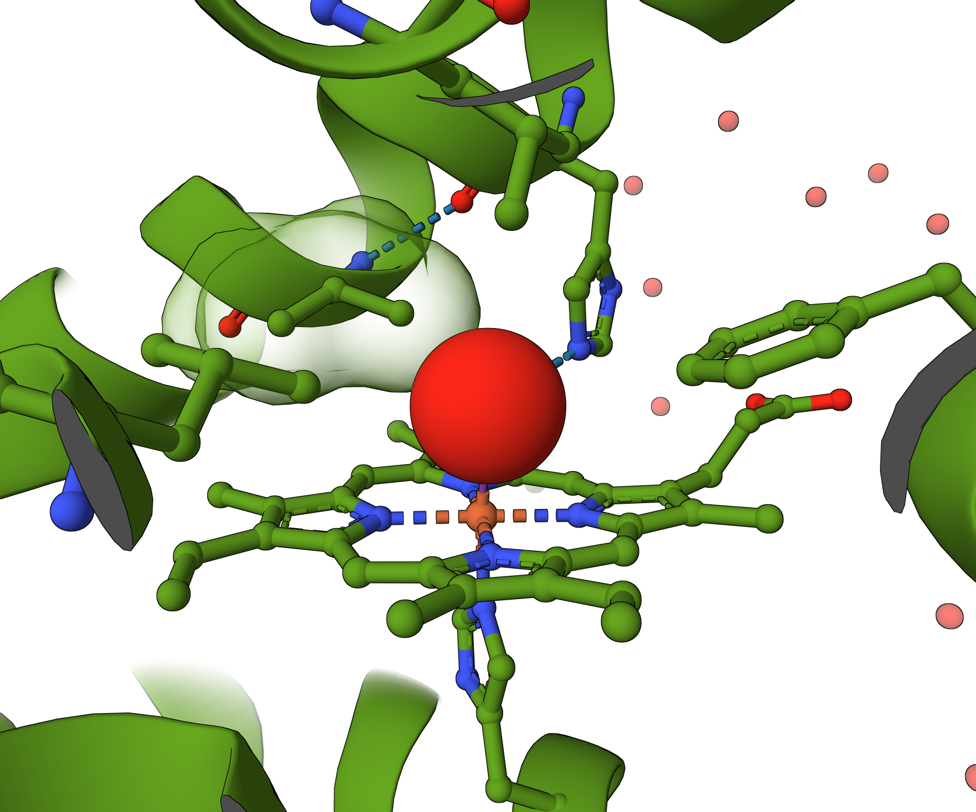
Mutant vs Native Hemoglobin 𝛄
Pig hemoglobin,
PDB ID 3a0g
V67M in PDB ID 4mqk, chain B
V67 in PDB ID 4mqj, chain B

Slide 8
Happy Ending
When the mutant Fetal Hemoglobin 𝛾 changes to Adult Hemoglobin β → there is no mutation, hence cyanosis
Explore UniProt https://www.uniprot.org/uniprotkb/P69892
Could the same mutation appear in Hemoglobin β?

Slide 9
Review Case and Learning Objectives
ASBMB
Structure and Function
3. Structure and function are related
4. Macromolecular interactions
7. The structure (and hence function) of macromolecules is governed by foundational principles of chemistry and physics
Scientific Skills
2. Accessing, comprehending and communicating science
(MSN) Systems in the Curriculum
Biochemistry
Impact of intramolecular interactions on protein structure, folding, influence on biological function
Intermolecular interactions of biopolymers and influence of polymer primary, secondary, and tertiary structure (DNA, RNA, proteins, etc.)
NIBLSE
Find retrieve and organize various types of bioinformatics data
Explore and/or model biological interactions, networks, and data interactions using bioinformatics
BioMolViz
Alternate Renderings
Ligands and modifications
Macromolecular assemblies
Molecular interactions
Structure Function Relationships
BioCore
Information Flow
Structure and Function

Slide 10
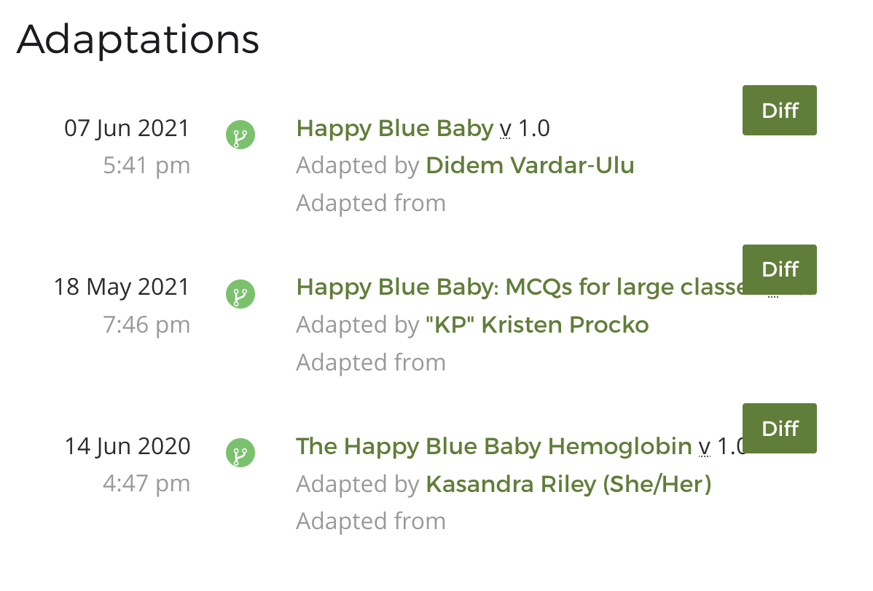
Adaptations
How would you adapt this case?

Slide 11
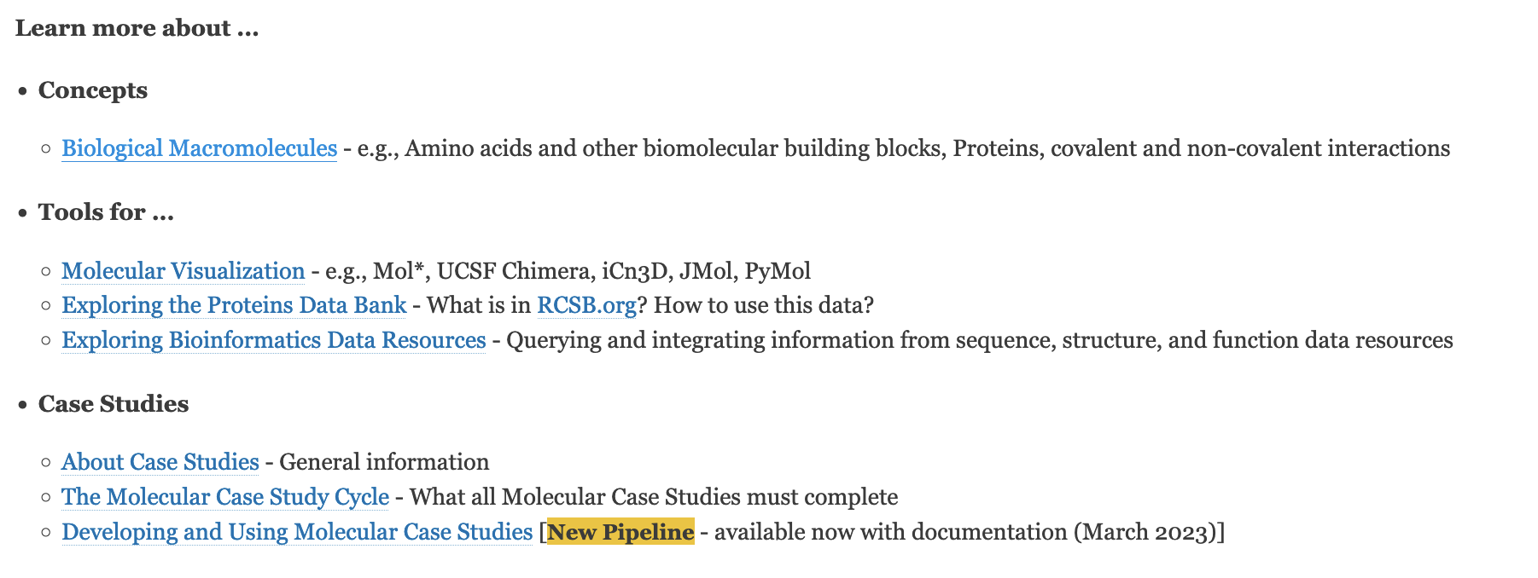
A Collection of Goodies
What else would you like to see here?

Slide 12
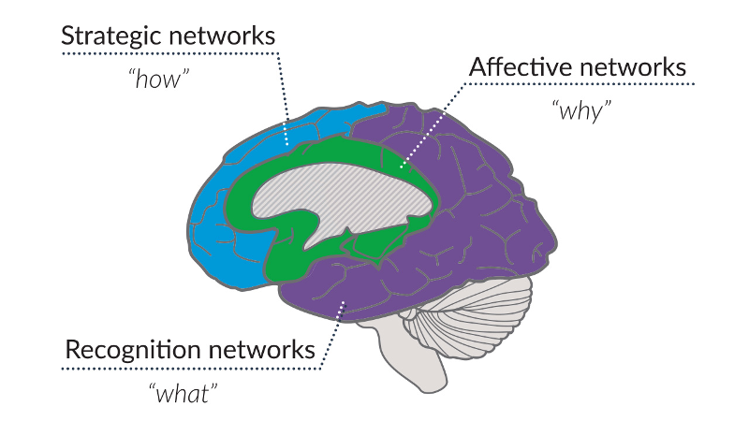
Outline
The Molecular Case Study cycle
Try a Molecular Case Study
Develop your Molecular Case Study
Invitation to join us
https://www.cast.org/products-services/resources/2018/udl-learning-brain-neuroscience

Slide 13
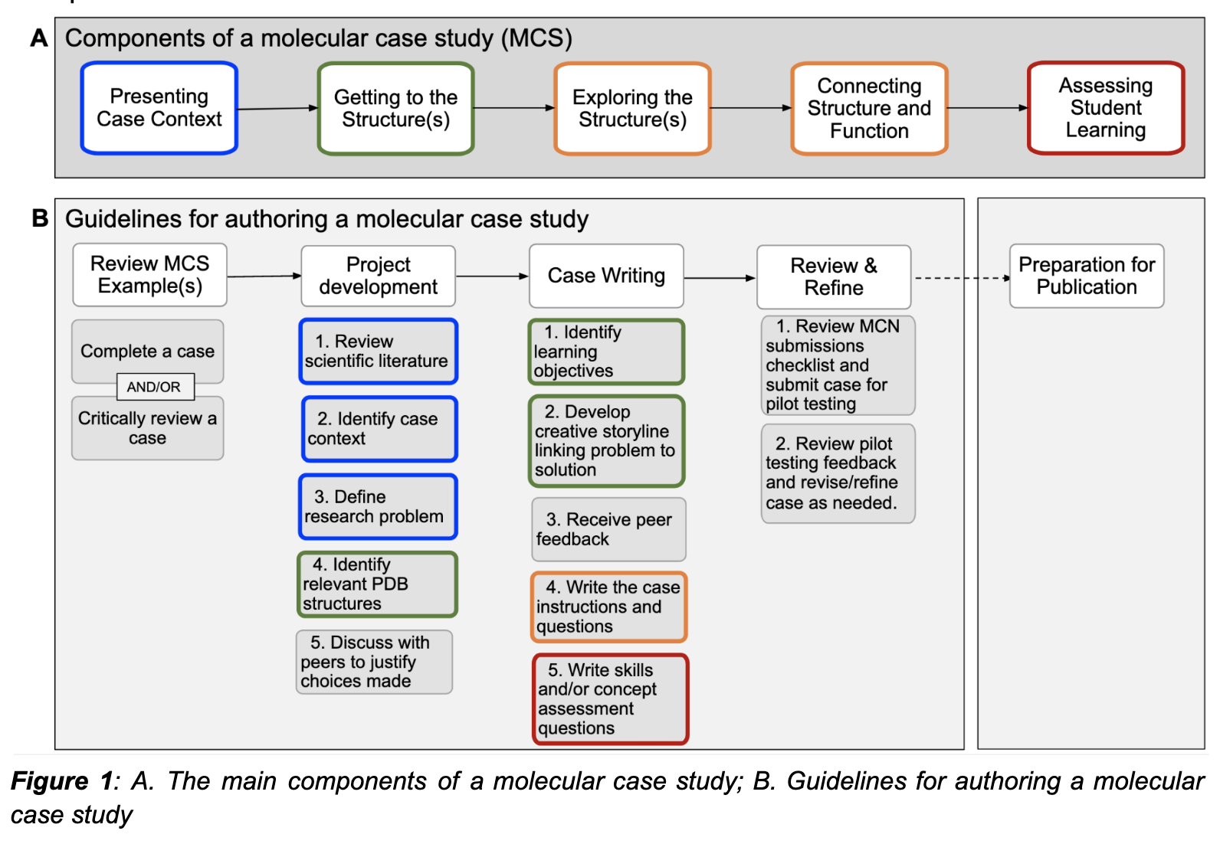
Authoring a Molecular Case Study

Slide 14
Why?
Select your topic
Why is this important?
Define a research question?
Are relevant structures present in the PDB? Identify them.

Slide 15
Share your “Why?”

Slide 16
What ?
Develop a creative storyline
Identify learning objectives
ASBMB Foundational concepts
Macromolecular, Supramolecular, and Nanoscale (MSN) Systems in the Curriculum
NIBLSE Bioinformatics Core Competencies
BioMolViz Framework
BioCore Guide
Write case instructions
Write Assessment

Slide 17
Share your “What?”
Email me your brainstorming results: sdutta@rcsb.rutgers.edu

Slide 18
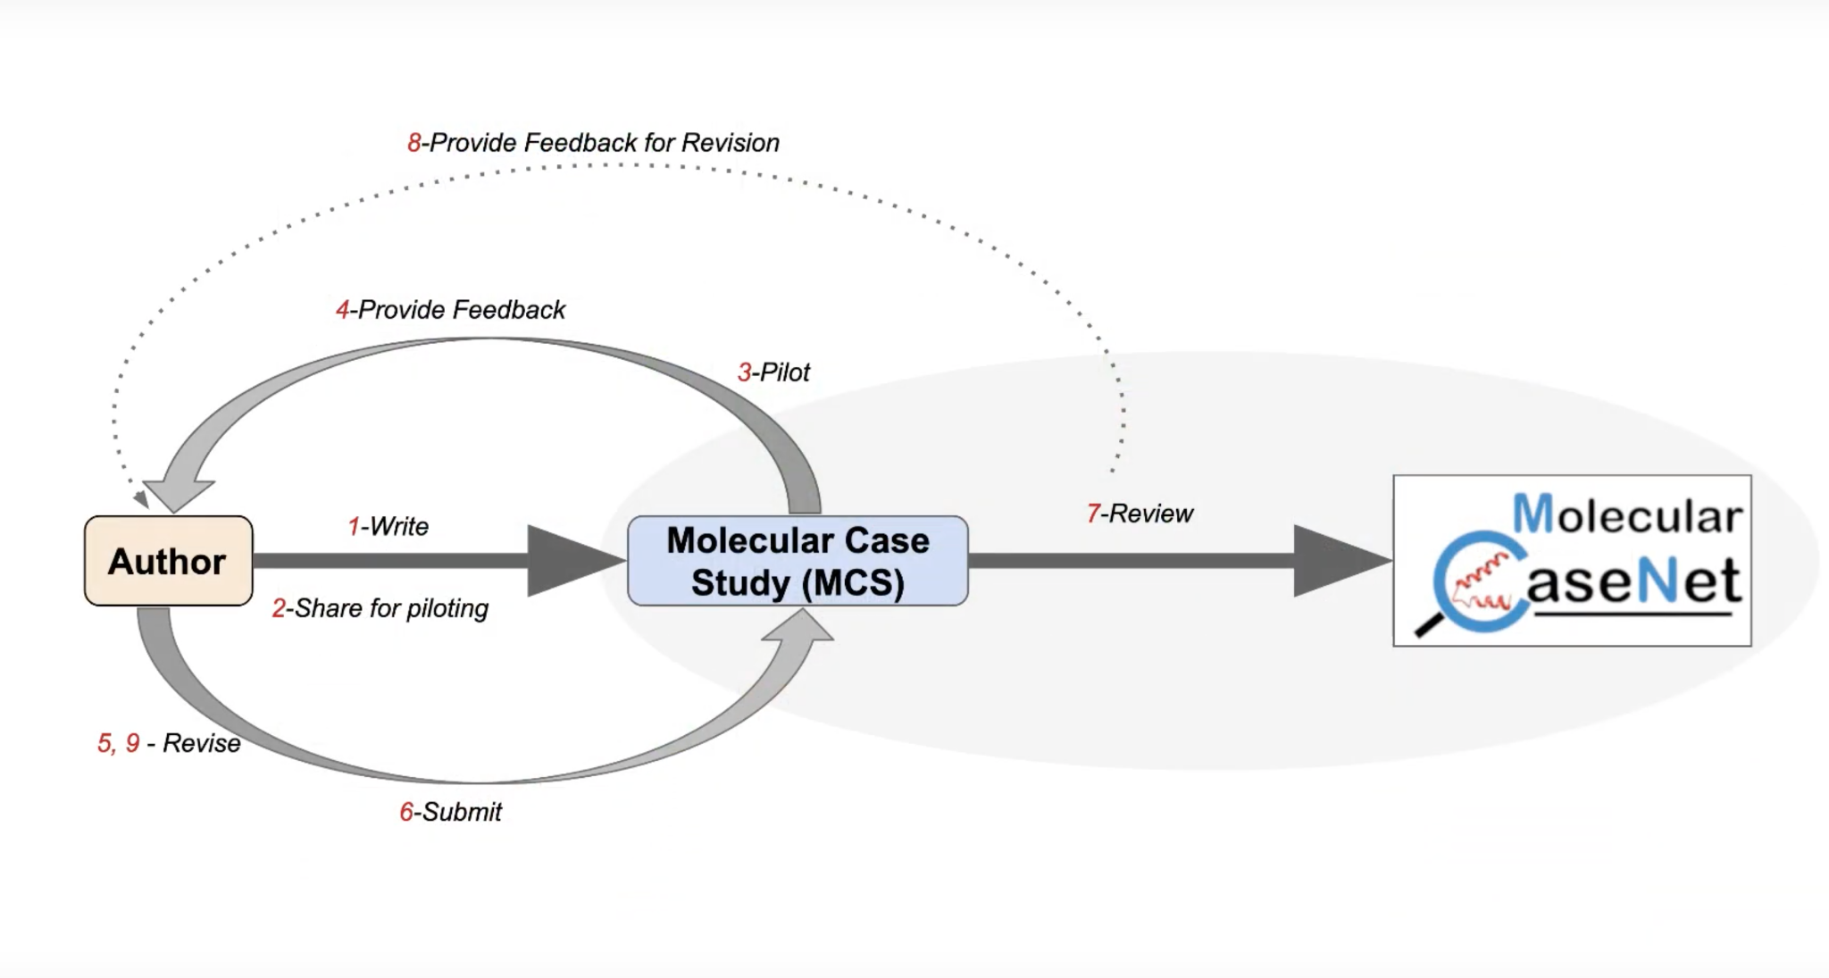
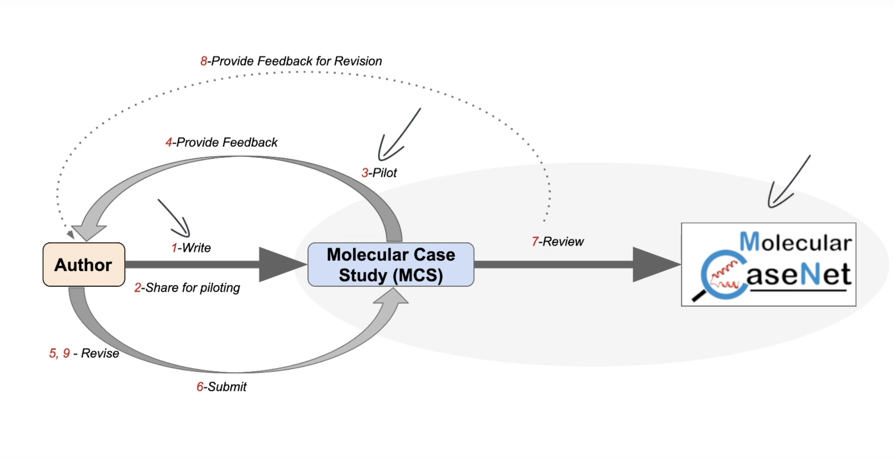
How ?
Write case instructions
Write skills and knowledge assessment
Write the Teaching Notes document

Slide 19
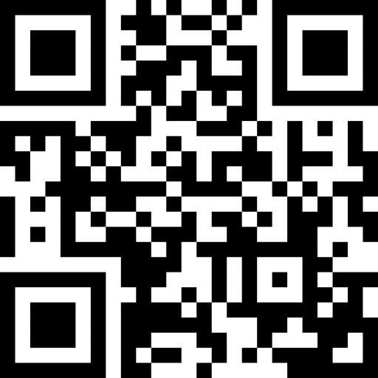
Outline
The Molecular Case Study cycle
Try a Molecular Case Study
Develop your Molecular Case Study
Invitation to join us
Use published case studies or case studies for piloting at https://molecular-casenet.rcsb.org/
as part of Cohort 3 to develop your own MCS
Begin in Sep./Oct. 2023
Expectation: Participate in 3 virtual sessions to write a draft for piloting
Brainstorming
Writing
Getting the MCS Teaching Ready
Pilot case study and prepare to publish

Slide 20
Summary
The Molecular Case Study Cycle
A quick review of key elements
Try a Molecular Case Study
Happy Blue Baby
Develop your Molecular Case Study
Creating an outline for your MCS
Invitation to join us
Use published or draft cases
Develop your own cases
Engage your students in writing case studies

