Slide 1
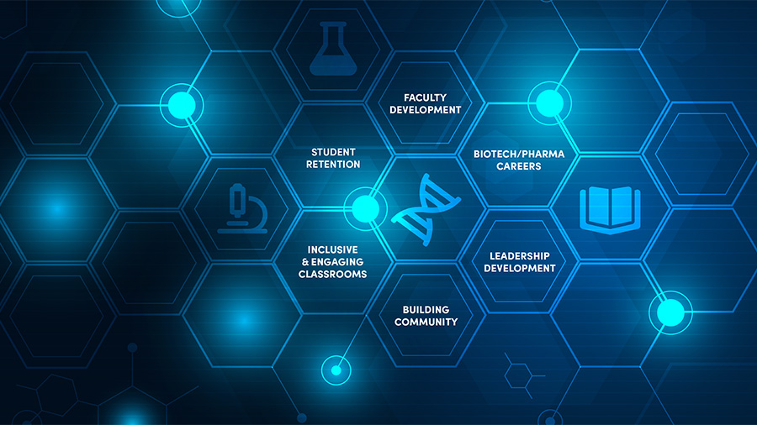
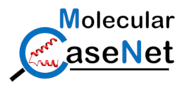
Molecular CaseNet:
Using a storytelling approach in exploring
biomolecular structure–function relationships
Shuchismita Dutta, Ph.D.
Scientific Training, Education, and Documentation Lead, RCSB Protein Data Bank
Associate Research Professor, Institute for Quantitative Biomedicine
Member, Cancer Pharmacology, Cancer Institute of New Jersey
Rutgers, The State University of New Jersey
Overview
Why use Molecular Case Studies?
The Molecular Case Study Cycle
How to connect with Molecular CaseNet?

Slide 2
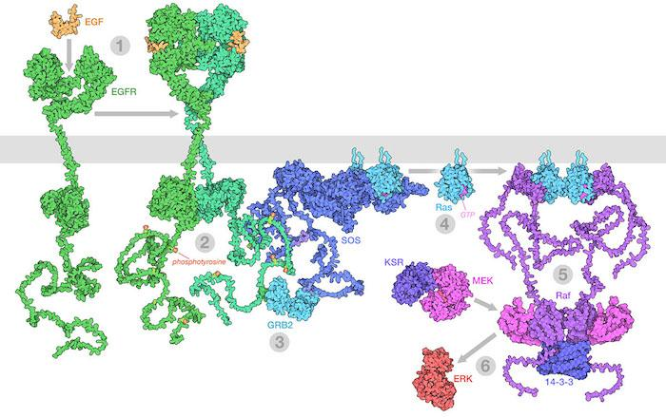
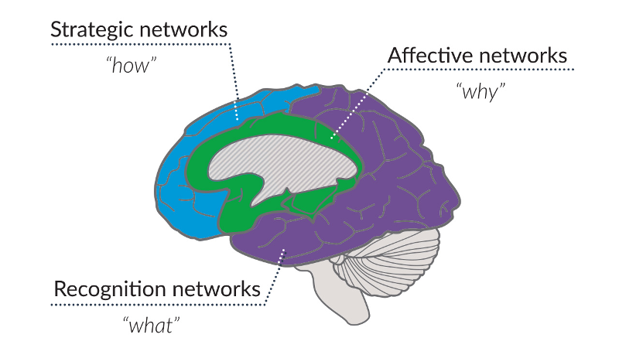
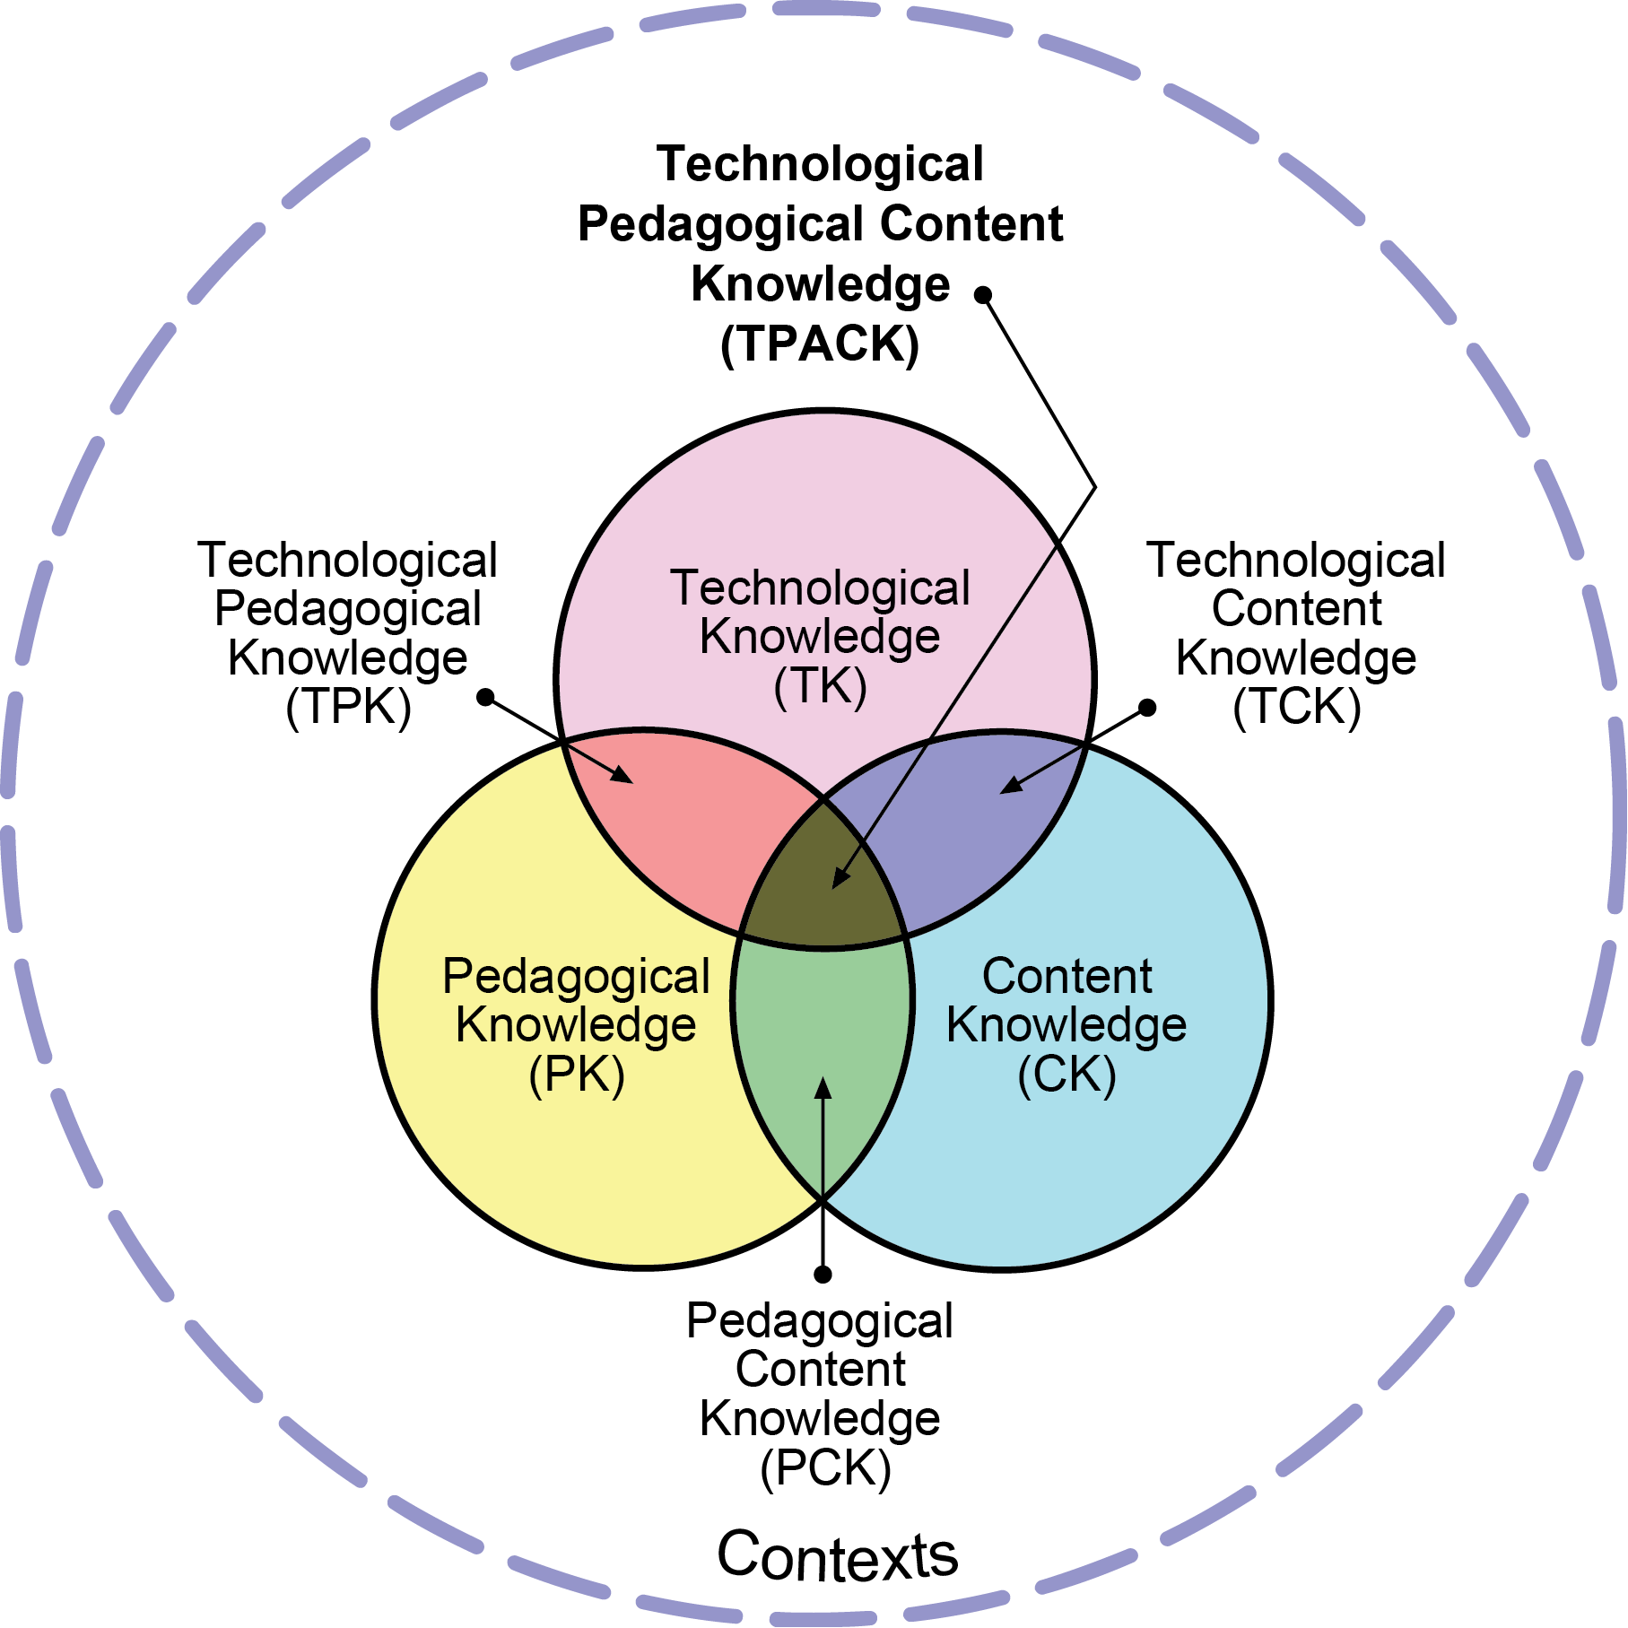
Molecular Storytelling: A Pedagogical Approach
https://www.cast.org/products-services/resources/2018/udl-learning-brain-neuroscience
Reproduced by permission of the publisher, © 2012 by tpack.org
https://pdb101.rcsb.org/learn/exploring-the-structural-biology-of-cancer

Slide 3
Why Use Molecular Case Studies?
Enable students/participants to …
query, navigate, and integrate information from various public bioinformatics resources (e.g., PDB, UniProt, PubMed, DrugBank, KEGG, and more) - aligned with NIBLSE Bioinformatics Core Competencies
visualize and analyze biomolecular structures - aligned with BioMolViz Framework
explore the molecular basis of biological phenomena - aligned with BioCore Guide
examine biomolecular structures for in-depth understanding of intra- and intermolecular forces in proteins, nucleic acids and their complexes facilitating their functions - aligned with Macromolecular, Supramolecular, and Nanoscale (MSN) Systems in the Curriculum
novel perspectives of real world problems and help develop solutions at the interface of biology & chemistry - aligned with ASBMB Foundational Concepts
They help you plan your curriculum because they are modular, flexible, and adaptable active learning opportunities. They are accompanied by answer keys and teaching notes, and include opportunities to apply multidisciplinary concepts learned in class to authentic societal issues.

Slide 4
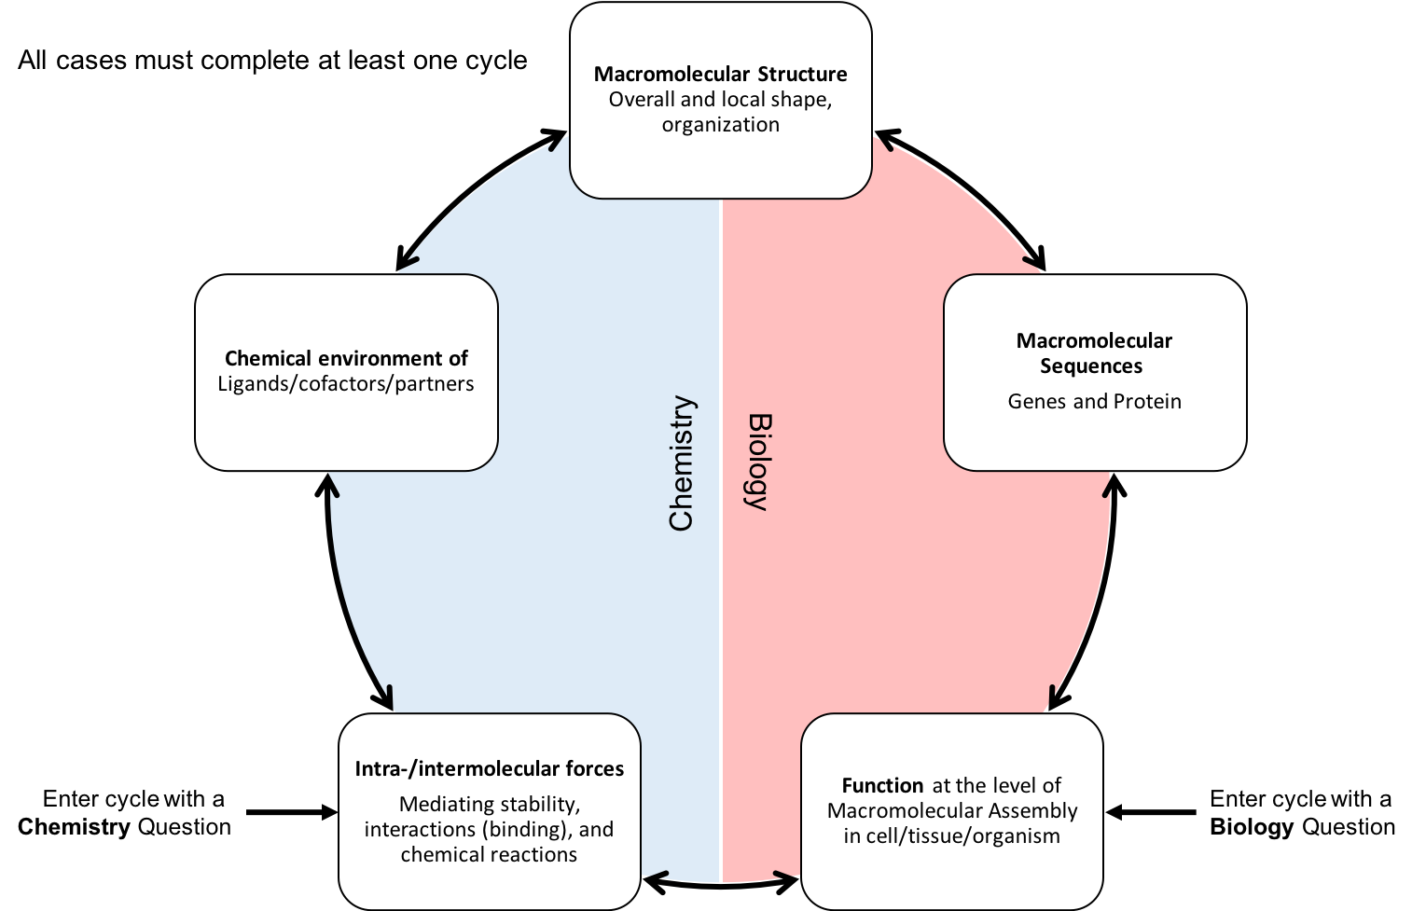
The Molecular Case Study Cycle

Slide 5
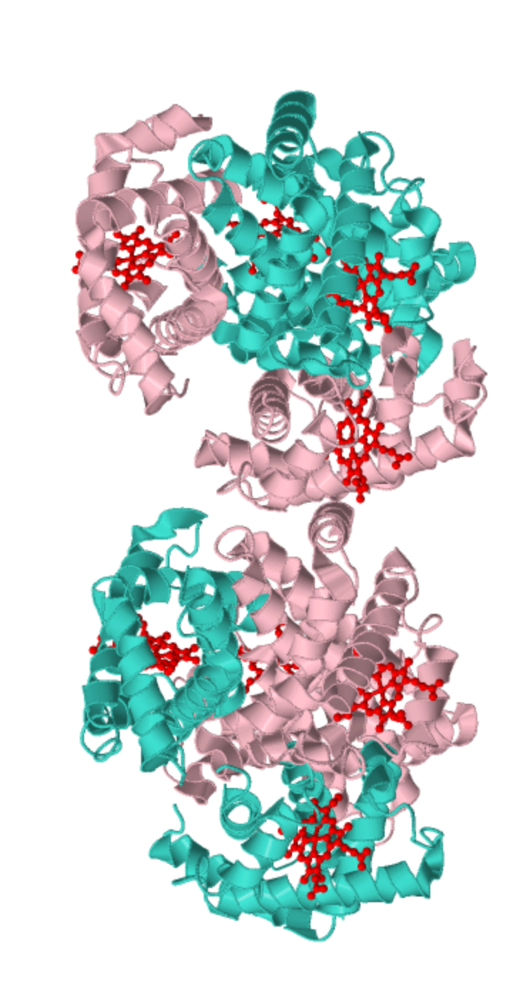
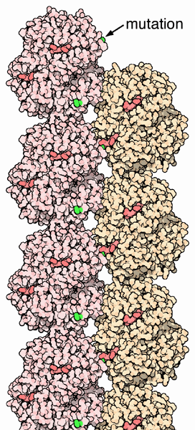
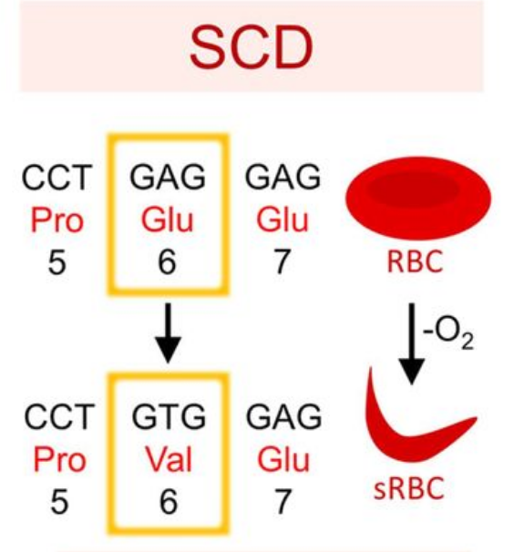
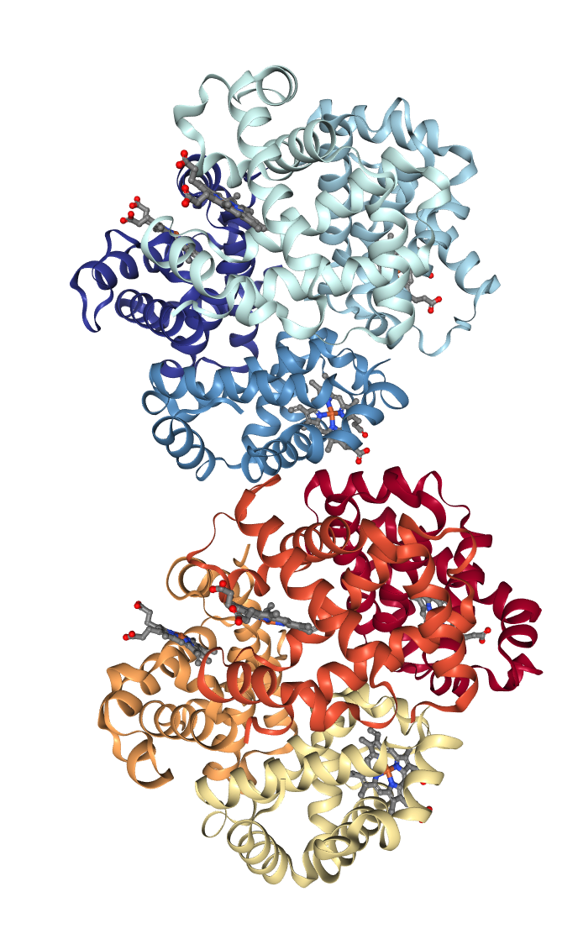
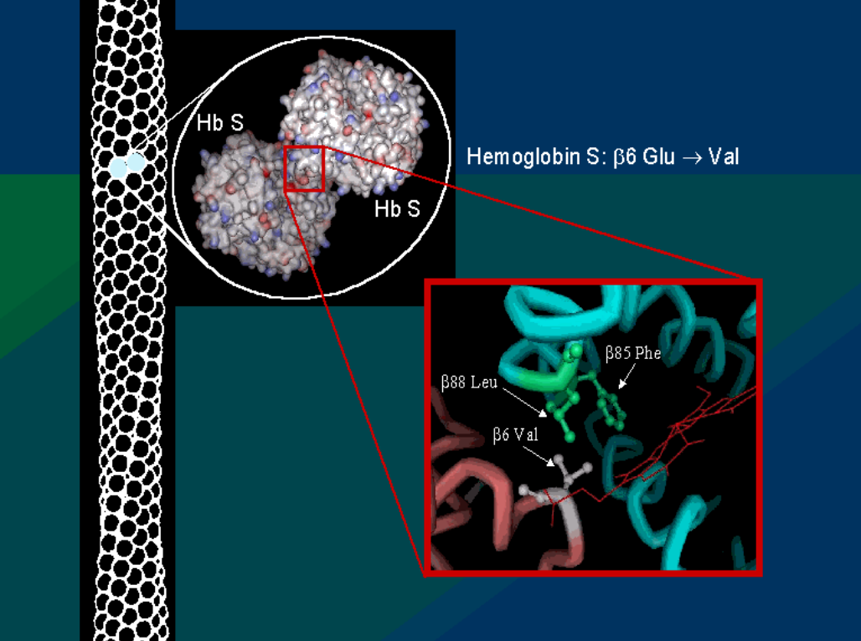
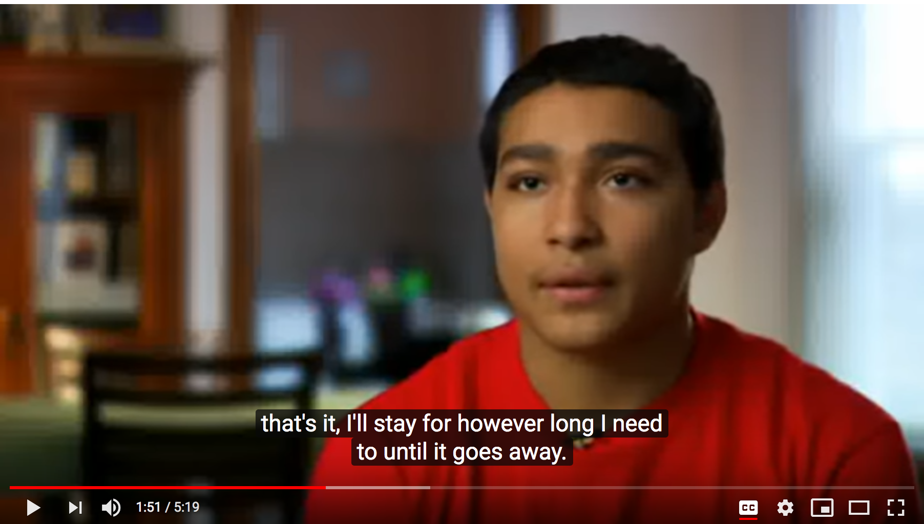
Nicholas’ Story
Goodsell, D.S., Dutta, S., Voigt, M., Zardecki, C. (2021) Molecular storytelling for online structural biology outreach and education; Structural Dynamics, 8(2); doi: 10.1063/4.0000077
Macromolecular Structure Overall and local shape, organization​
Molecular Exploration
Getting to Structure
OMM
Chemical environment​ of Ligands/cofactors/partners
Macromolecular Sequences ​
Genes and Protein​
Mutation of Glu6Val in HbS
Chemistry
Biology
Deoxy HbS structure (PDB ID 2hbs)
RCSB PDB
PDB-101
OMM
Intra-/intermolecular forces
Mediating stability​, interactions (binding),​ and chemical reactions
Function at the level of Macromolecular Assembly in cell/tissue/organism
Enter cycle with a
Chemistry Question
Enter cycle with a
Biology Question
Introduction
Q1. What is the molecular basis for Nicholas’ pain crises?

Slide 6
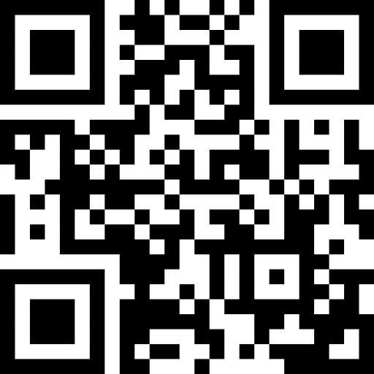
How to connect with Molecular CaseNet?
Join to use
published case studies or case studies for piloting at https://molecular-casenet.rcsb.org/
Join the new Cohort in Fall 2023 (Sep./Oct.) to author your own molecular case study
Scan QR code to complete an interest form

Slide 7
Summary
Why use Molecular Case Studies?
The Molecular Case Study Cycle
How to connect with Molecular CaseNet?
Hope to see you in a Showcase Sessions later today

