Slide 1
Teaching biology with real world examples and molecular storytelling
Rashmi Capece; Dept. of Chemistry, Berea College, Berea, KY; capecer@berea.edu
Emily Schmitt Lavin; Dept. of Biological Sciences, Nova Southeastern University; Ft. Lauderdale, FL; eschmitt@nova.edu
Consistently we find that students LOVE these applied examples using easily available resources from the Protein Data Bank.
Using these resources reinvigorates us as we teach important molecular and biochemical concepts using Molecular Cases.
We hope that you will be inspired to do the same.

Slide 2
Making Molecular and Structural Biology Engaging for Students through Storytelling
Our Examples and How to Approach Making Your Own - while showing students resources (Protein Data Bank, including Mol*, and more)
Deubiquitinating Enzyme and MIC-CAP Syndrome
  (Daisy’s Doula Job)
Krebs Cycle Enzymes and Cancer Treatment
  (Missy’s Story)

Slide 3
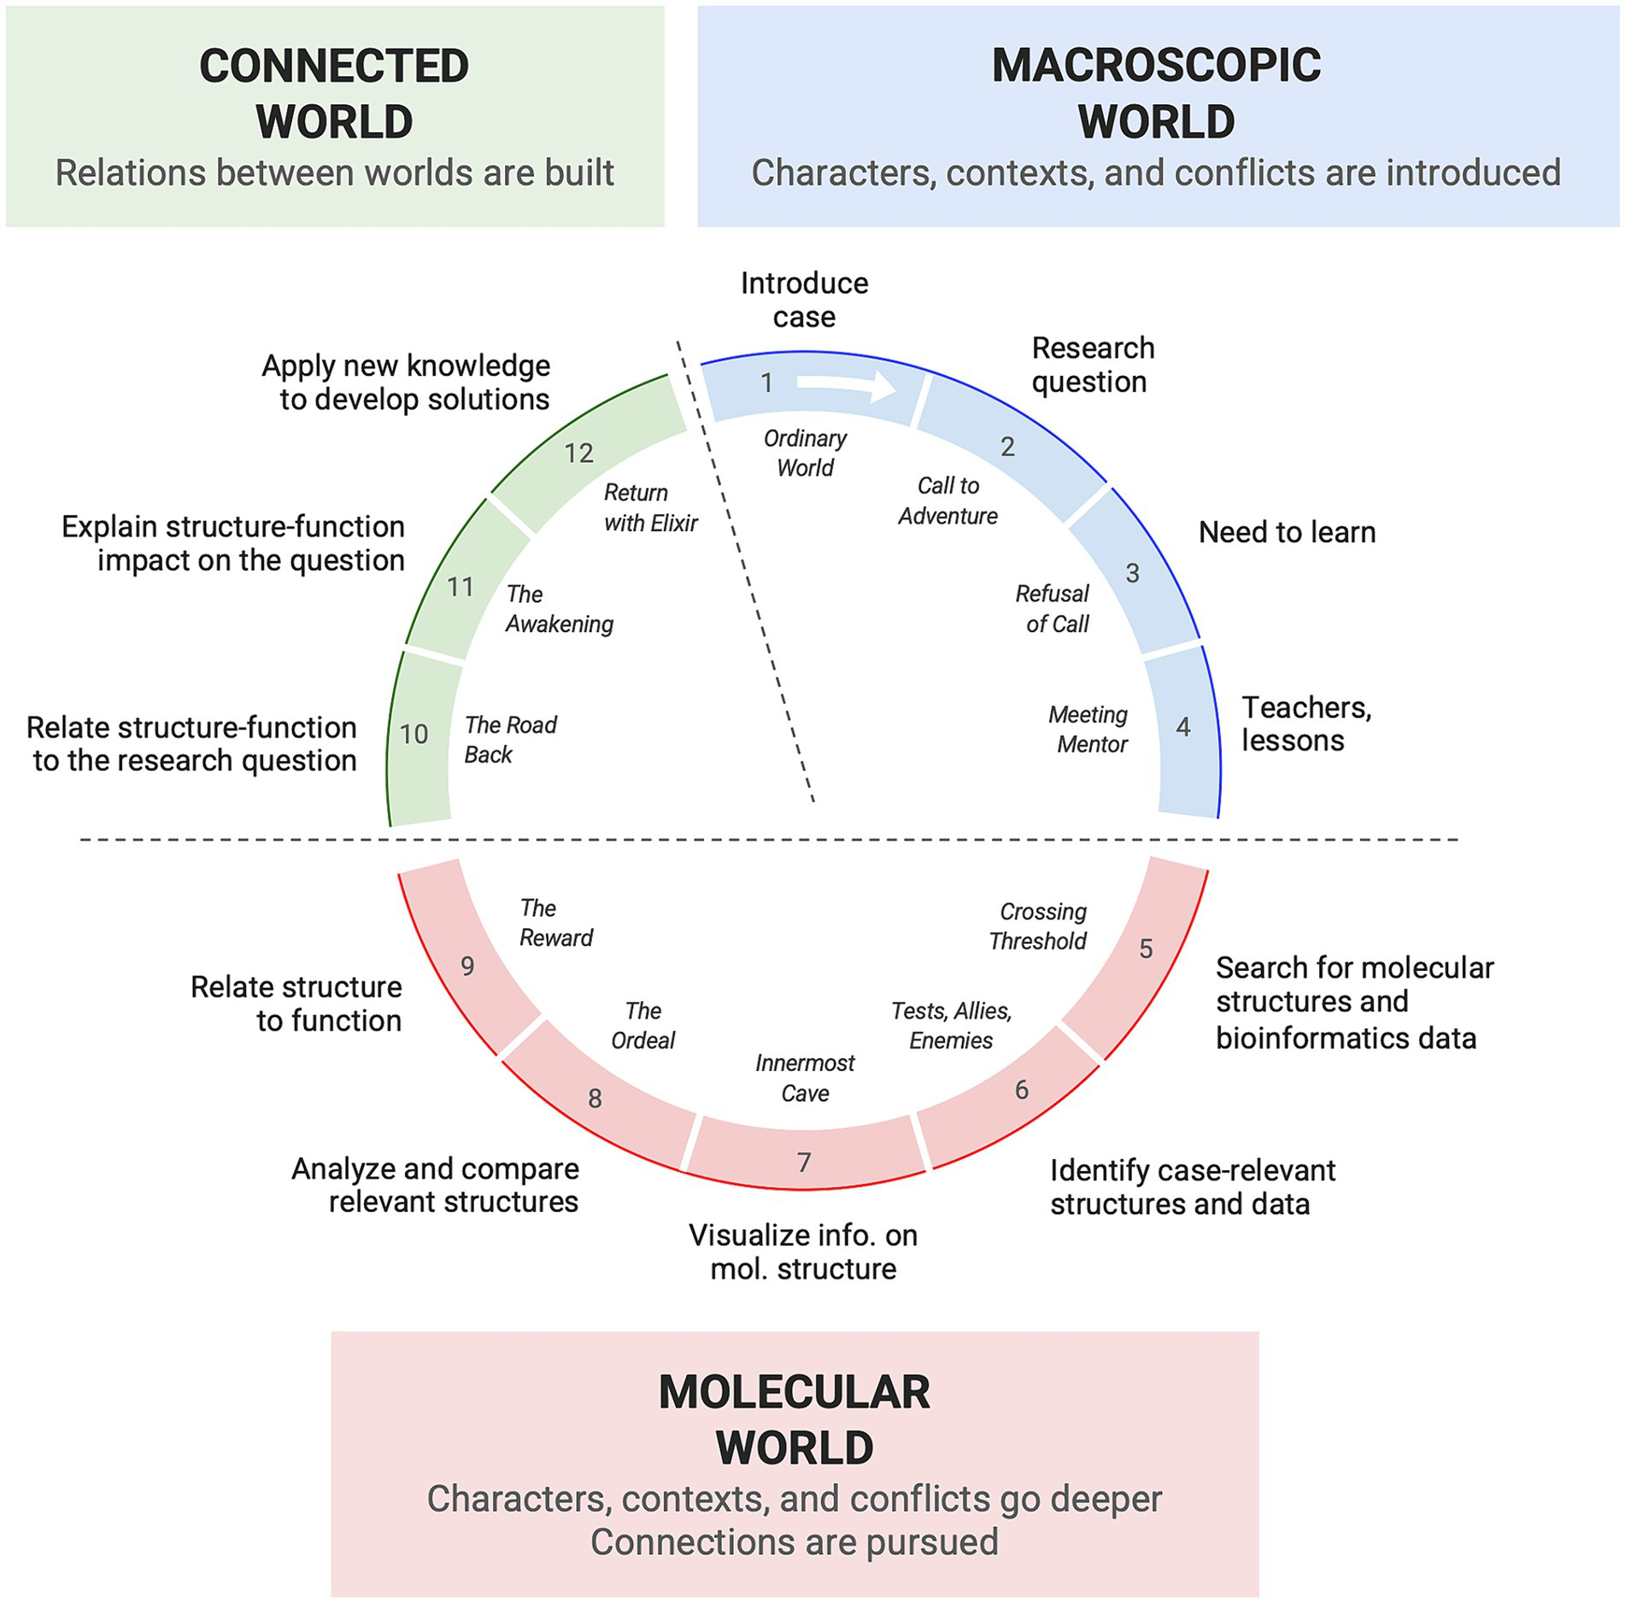
Hero’s Journey of making a molecular case study
Connecting the molecular and macroscopic world
chemistry and biology - Faculty Mentoring Network - Protein Data Bank Tools
DOI:10.3389/feduc.2024.1379515 (Figure 4)

Slide 4
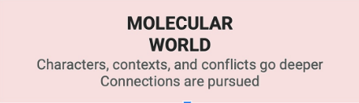
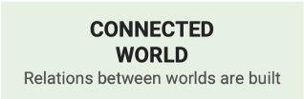
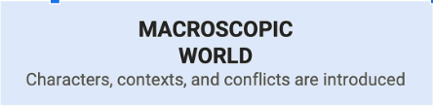
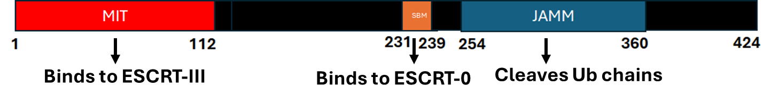
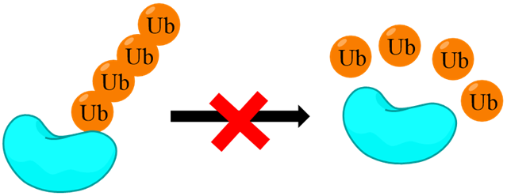

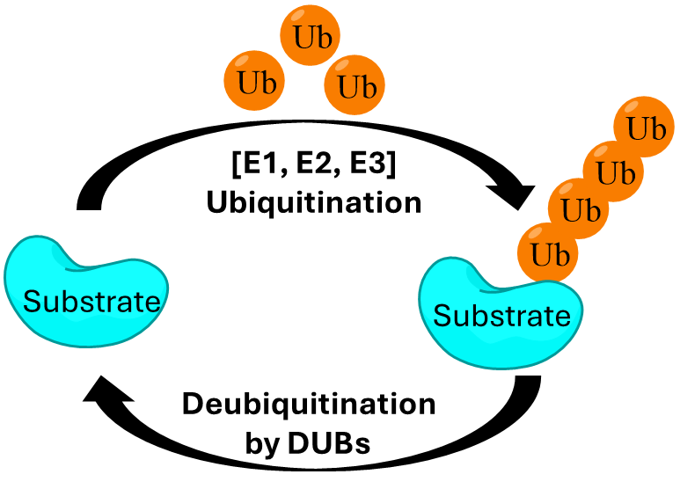

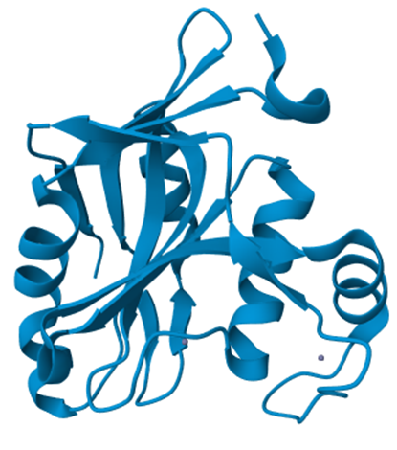
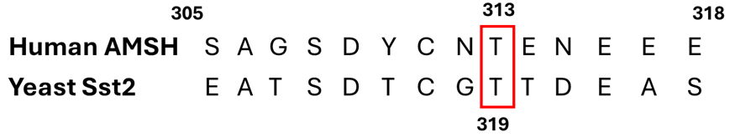
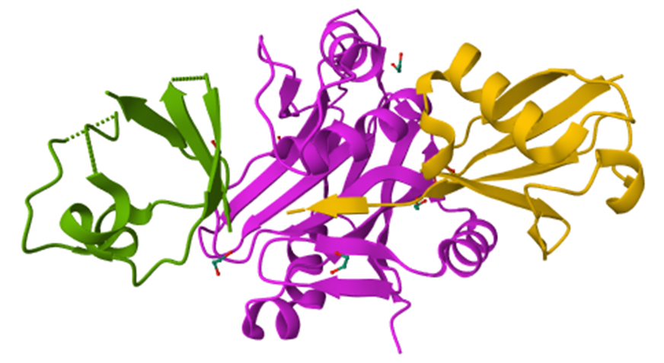
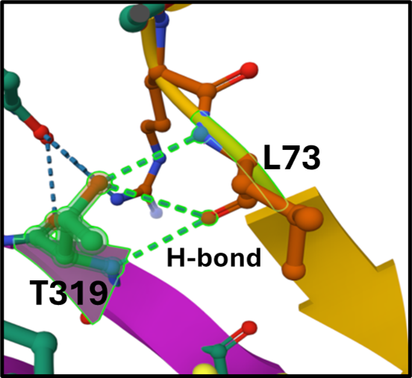
Daisy’s Doula Job
Daisy- Certified doula, third year undergraduate majoring in Biochemistry worked for a family with a newborn during summer.
T313I
The newborn had a small-sized head and developed seizures shortly after birth. Doctors diagnosed the baby with Microcephaly Capillary (MIC-CAP) malformation syndrome.
Human AMSH
(PDB: 3RZU)
Accumulation of ubiquitinated proteins
Ubiquitin (Ub)- a death tag that helps in protein degradation
ESCRT-mediated lysosomal degradation of proteins is essential for neuronal differentiation.
Interfering with this pathway disrupts brain development, leading to microcephaly, and impacts brain activity, which can cause epilepsy.
Sequence Alignment
Research Question: How does the mutation T313I in AMSH results in microcephaly and epilepsy in MIC-CAP syndrome?
Sst2, AMSH ortholog in yeast,
(PDB:4NQL) bound to diUb
T319 interacts with substrate (Ub, L73) and hold in the right place for cleaving.
Rare genetic disorder with no cure and limited support groups are available to help affected parents.
AMSH, a deubiquitinating enzyme (DUB) involved in cell surface receptor-mediated endocytosis and sorting carried out by ESCRT machinery.
AMSH: Associated molecule with the SH3 domain of STAM
ESCRT: Endosomal sorting complexes required for transport

Slide 5
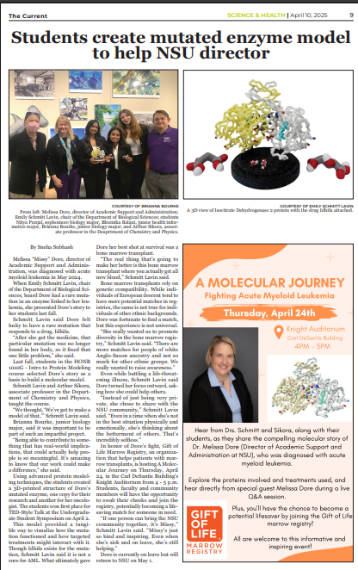
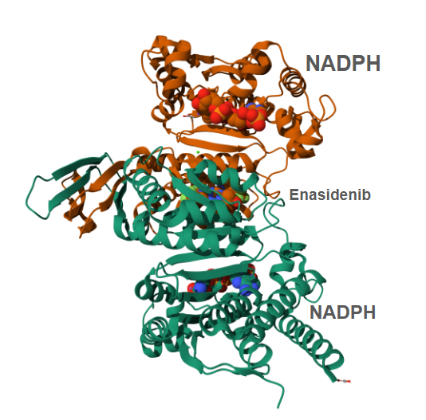
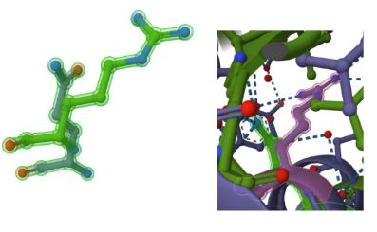
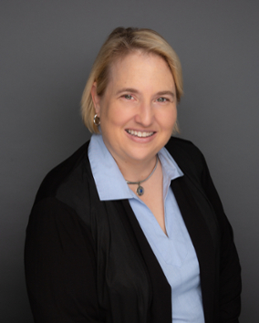
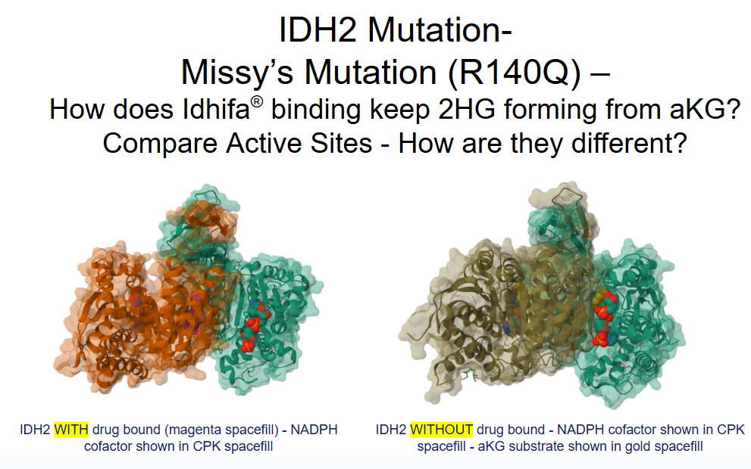
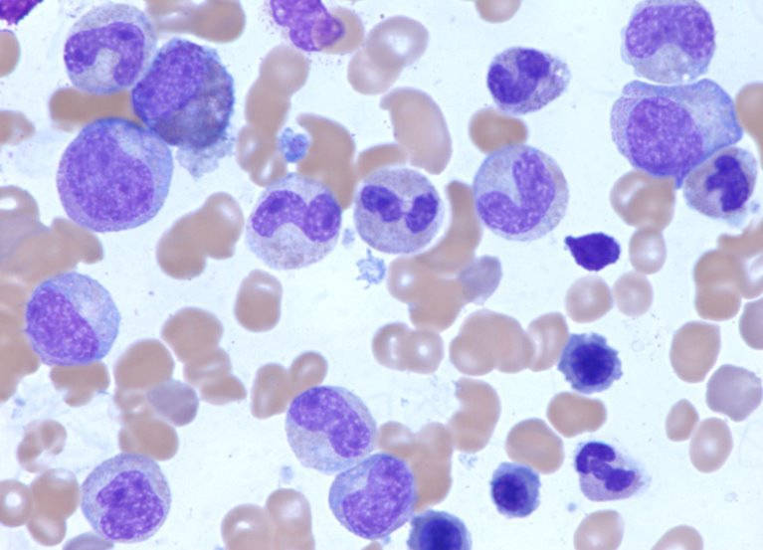
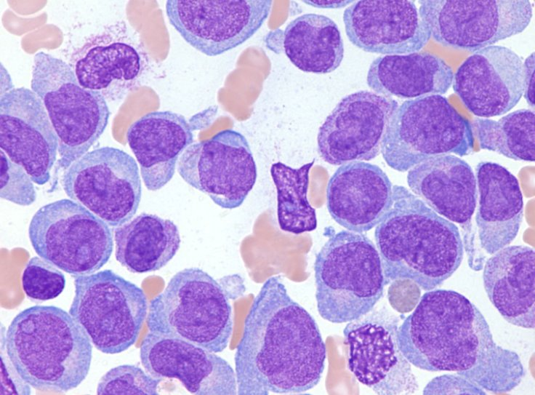
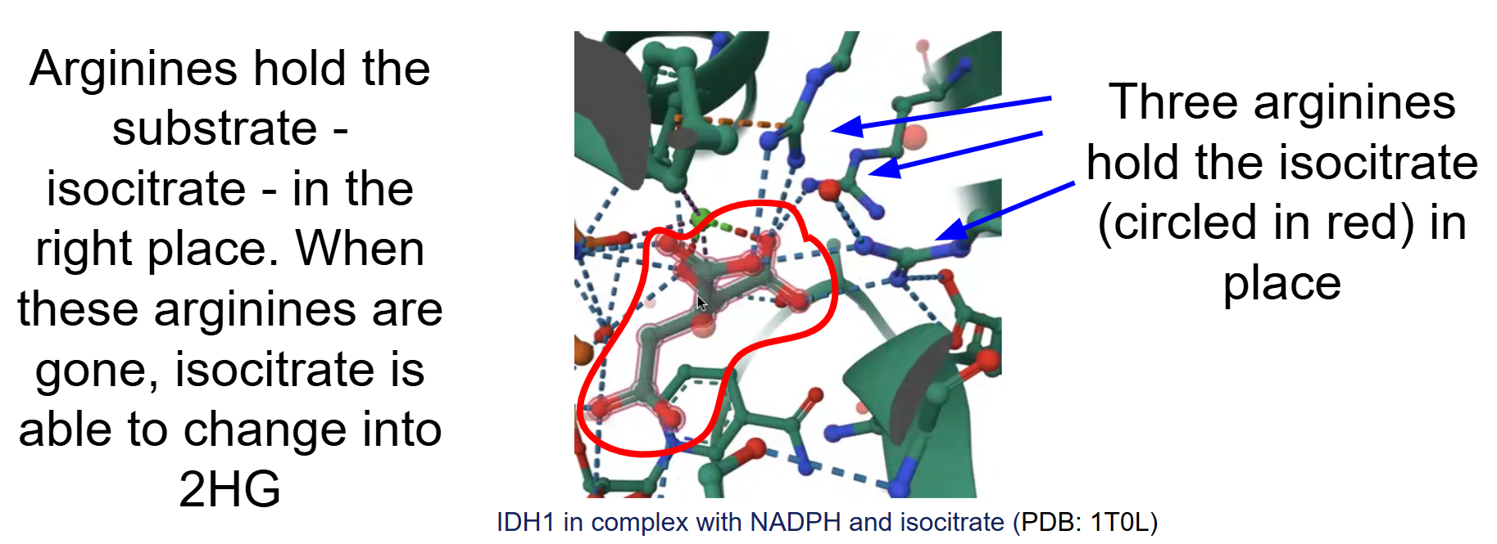
Missy’s Story
A member of our community, Dr. Missy Dore - got sick with Acute Myeloid Leukemia and shared one of her medicines and the mutation it targets - “I have a rare mutation in a Krebs Cycle enzyme and get to take a drug to fix it”
IDH2 with drug (PDB: 5I96)
R vs Q Mutation at 140
A video interview was produced documenting this story
Long Version (14.32 min)
Click to play video
Short Version (5:32 min.)
Click to play video
Bone Marrow
Research Question: How does the drug binding to the mutant Isocitrate Dehydrogenase II (IDH2) enzyme counteract the effects of the R140Q mutation in patients with acute myeloid leukemia (AML)?
Healthy
AML
Images taken from: https://together.stjude.org/en-us/about-pediatric-cancer/types/leukemia/acute-myeloid-leukemia-aml.html
The problem comes when…
isocitrate → αKG → 2HG
It is the 2HG that causes blood cells to stay immature by other pathways not discussed in this case.
Campus awareness and bone marrow registration events on campus
https://www.giftoflife.org/swab

Slide 6
How did you develop this story?
(Daisy’s Doula Job)
1. Familiar with the protein in graduate school
Worked with Sst2 and determined the structure with diubiquitin
Learned about the MIC-CAP syndrome caused by different mutations in AMSH
A fictional story that describes a doula’s investigation into understanding the characteristics of a MIC-CAP syndrome.
A case study that focuses on a single mutation in AMSH and examines AMSH and Sst2 structures and sequences.
A molecular story of how mutation affects substrate binding, leading to the disease.
2. Inspiration for the “Hook”
Met a couple of students in my college who were doula certified
One of them was in my Biochemistry class who was planning to go to medical school
Came across another student who was interested in traditional medicine, inspired by their grandmother
Joined Faculty Mentoring Network 2024-2025

Slide 7
How did you develop this story?
(Missy’s Story)
Worksheet and teaching resources available separately
1. Working with students on protein modeling and molecular storytelling at NSU
Collaboration with 3D Molecular Designs from their CREST (Connecting Researchers Educators and STudents) and SMART (Students Modeling a Research Topic) Teams
Joined Molecular CaseNet Faculty Mentoring Network 2024-25
The Molecular Case describes how the medicine binds to the Krebs Cycle Enzyme, Isocitrate Dehydrogenase (IDH2), and treats Acute Myeloid Leukemia (AML)
The effect of the mutation from arginine (R) to glutamine (Q) and the role of the medicine are examined through structural molecular visualization and online freely available tools
2. Inspiration for the “Hook”
Colleague (Missy) shared that she would be taking a special medicine to target Krebs Cycle enzyme to treat Acute Myeloid Leukemia mutation that had been found in her cells
Students conducted video interview with Missy and were excited to tell her molecular story

Slide 8
Acknowledgements
The development of these cases were a direct product of the Faculty Mentoring Network Program. We would like to especially thank Drs. Shuchismita Dutta and Keith Johnson of the Molecular CaseNet program for the community and guidance in developing this molecular case. We are thankful to the entire Molecular CaseNet Learning Community. Thank you to Dr. Melissa Dore for sharing her Acute Myeloid Leukemia treatment journey through this molecular case development. We also acknowledge our students at Berea College and Nova Southeastern University for inspiring us and providing feedback as they used these case studies.

